Slide 1
HADOOP CLUSTER
PROJECT MEMBERS:
Priyanka Sreerama
Rupak Kumar Das

Slide 2
Our Agenda :
How Hadoop features Parallel computing ability using distributed file system –HDFS and runs a MapReduce Job for processing.
For this we created Five node Multi-node Hadoop Cluster on our machines and used a text input for MapReduce and large clinical data file for PIG
System requirements and Technologies used are:
16GB RAM and 1 TB HARDDISC
OS – CentOS
Hadoop 2 version
Java , eclipse

Slide 3
Why Hadoop?
In today’s world we hear lot about data and with the humongous data increase companies demand a cost-effective, innovative solution to store and analyze it. Hadoop is the answer to all Big Data requirements.
Why Hadoop is Important?
Flexible:
Scalable
Building more efficient data economy:
Robust Ecosystem:
Hadoop is getting more “Real-Time”!
Cost Effective:
Upcoming Technologies using Hadoop:
Hadoop is getting cloudy!

Slide 4
What is Hadoop?
Apache Hadoop is a framework that allows storage and processing of huge data sets across the Hadoop cluster in a distributed and parallel fashion
Hadoop cluster is highly scalable and uses commodity hardware which are relatively cheaper.
Core features of Hadoop are:
HDFS (Hadoop Distributed File System) – data storage
MapReduce Framework – compute in distributed environment

Slide 5
Hadoop Configuration files
Configuration Filenames | Description of Log Files
hadoop–env.sh | Environmental variables that are used in the scripts to run Hadoop.
core-site.xml | Configuration settings for Hadoop core such as I/O settings that are common to HDFS and MapReduce.
hdfs-site.xml | Configuration Settings to HDFS daemons, the namenode, the secondary namenode and the Datanodes.
mapred-site.xml | Configuration settings for MapReduce applications
yarn-site.xml | Configuration settings for ResourceManager and NodeManager
masters | A list of machines (one per line) that each run on a Secondary NameNode.
slaves | A list of machines (one per line) that each run a Datanode and a NodeManager.

Slide 6
Hadoop core components
Core Components
HDFS
YARN
NameNode
Master
Resource Manager
Secondary NameNode
DataNode
Slave
Node Manager

Slide 7
Hadoop Daemons
NameNode
Runs on master node of the Hadoop Distributed file system (HDFS)
Direct Data Nodes to perform their low-level I/O tasks
DataNode
Runs on each slave machine in the HDFS
Does the low-level I/O work
Resource Manager
Runs on master node of the Data processing System (MapReduce)
Global resource Scheduler
Node Manager
Runs on each slave node of Data Processing System
Platform for the data processing tasks
Job History Server
Runs on each slave node of Data processing system
Platform for the data processing tasks

Slide 8
Core Components of HDFS
NAMENODE:
Master Node
Maintains and manages the blocks which are present on the DataNodes
DATANODE:
Slave nodes which are deployed on each machine and is responsible for storing the data
Responsible for serving read and write requests for the clients

Slide 9
Hadoop Multi-node cluster setup and MapReduce

Slide 10
Hadoop Cluster Architecture – Master Slave Technology

Slide 11
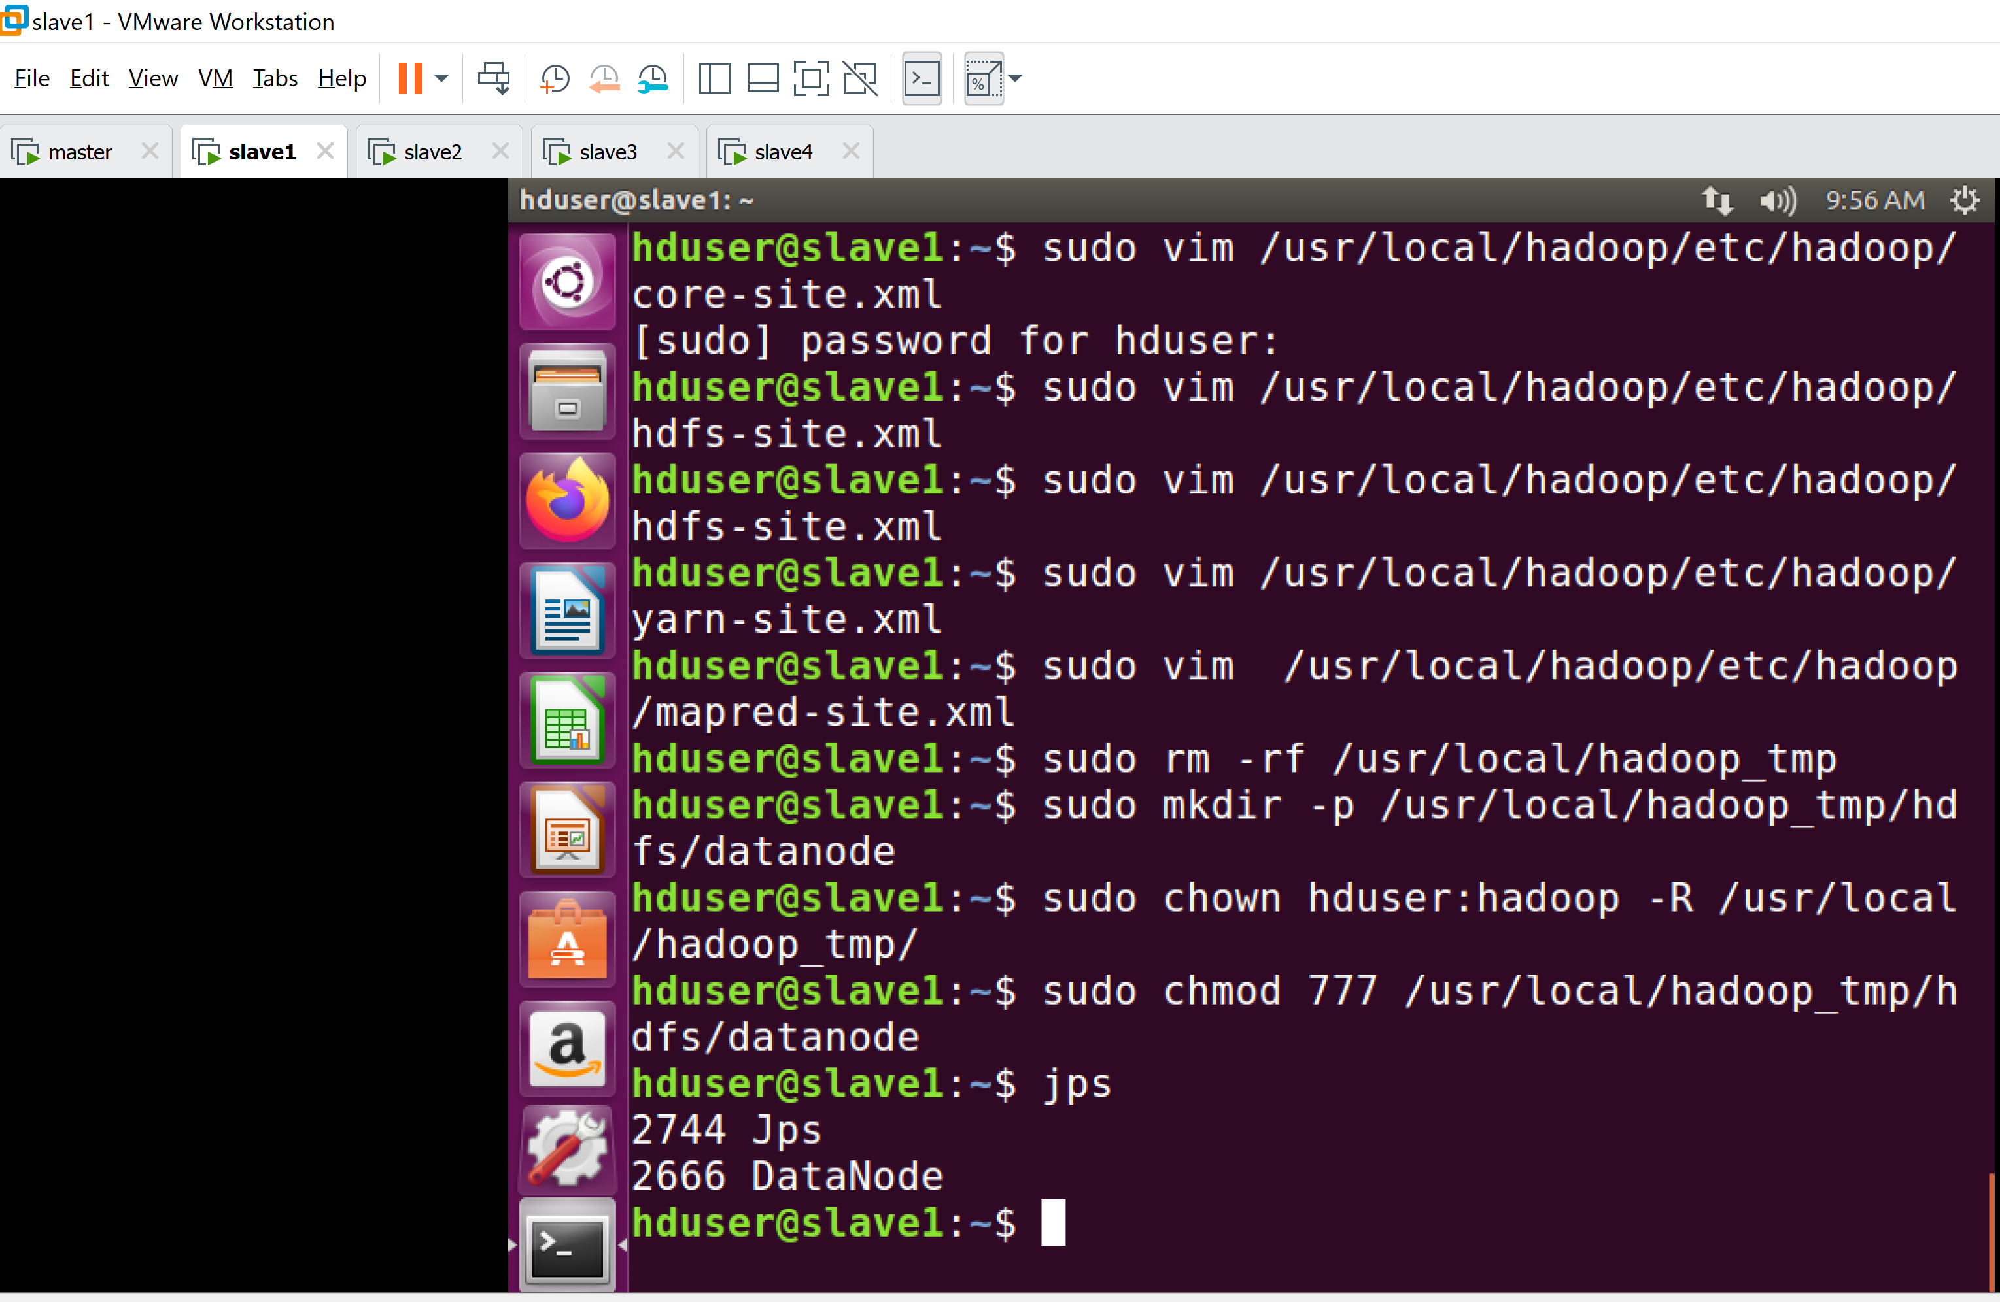
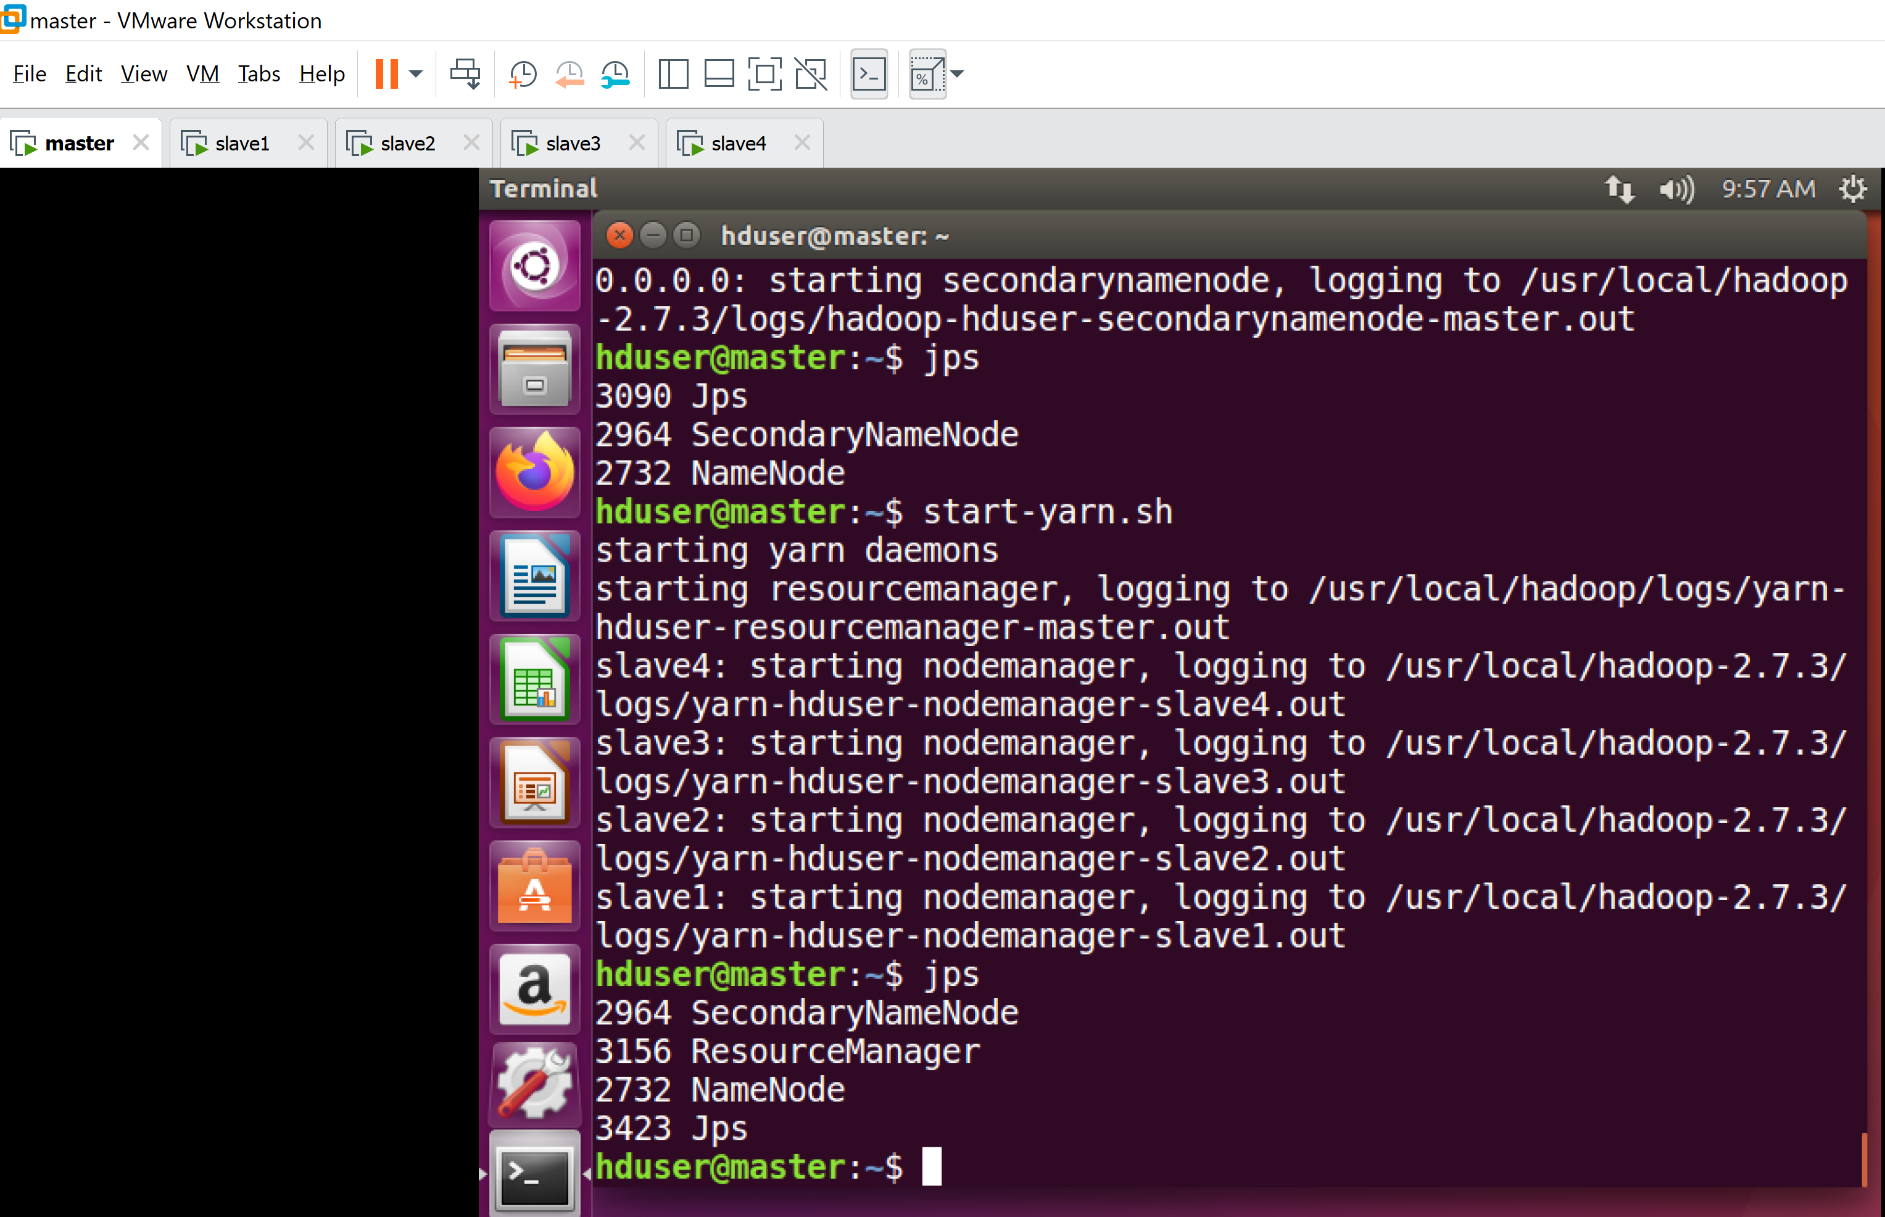
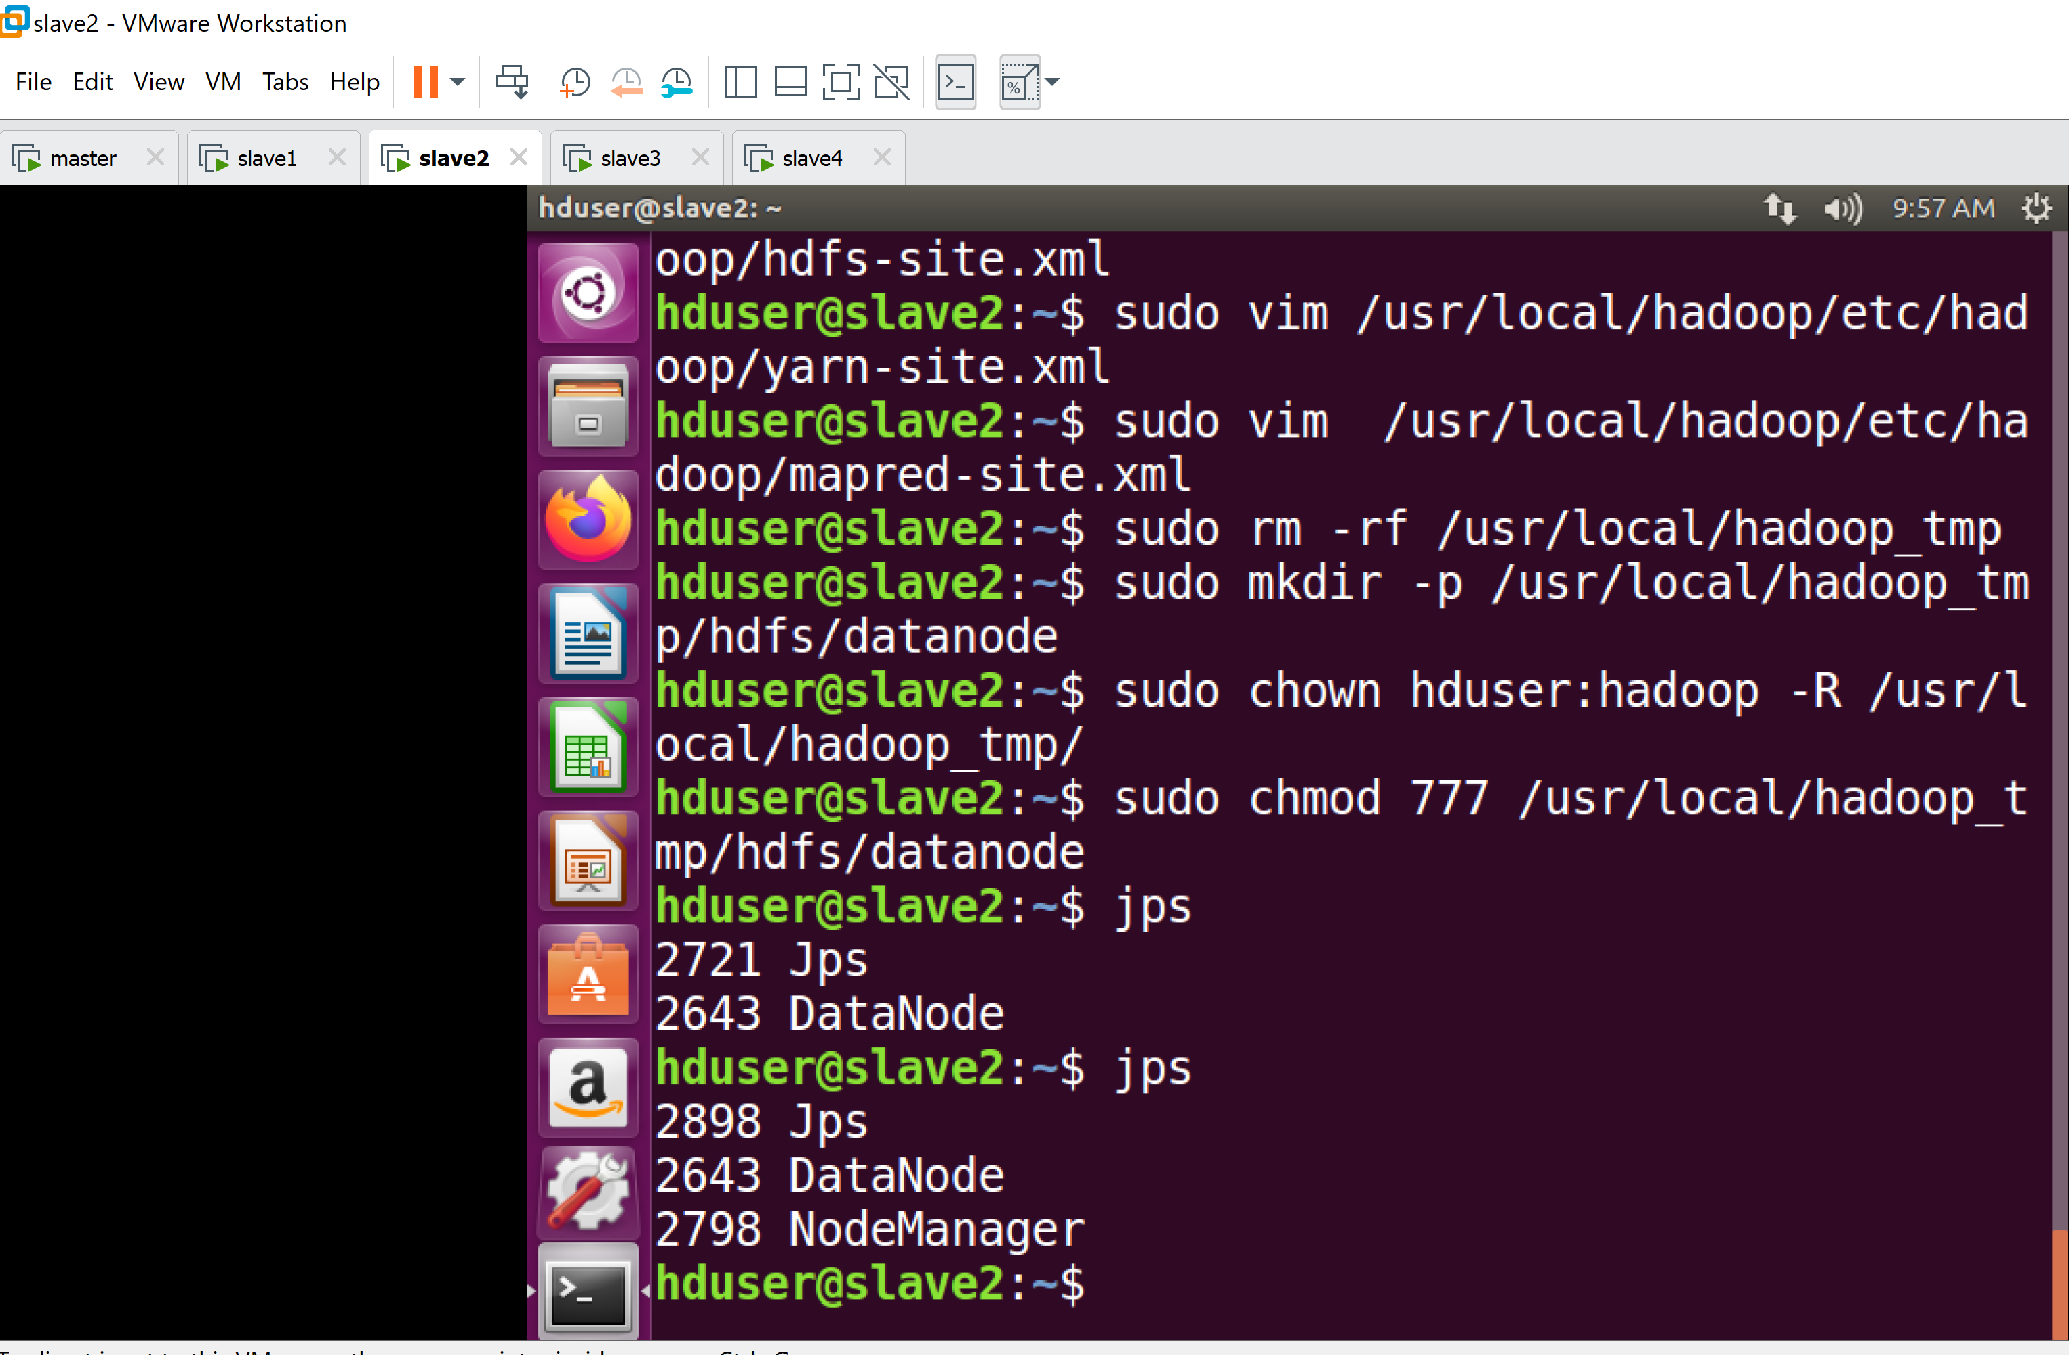
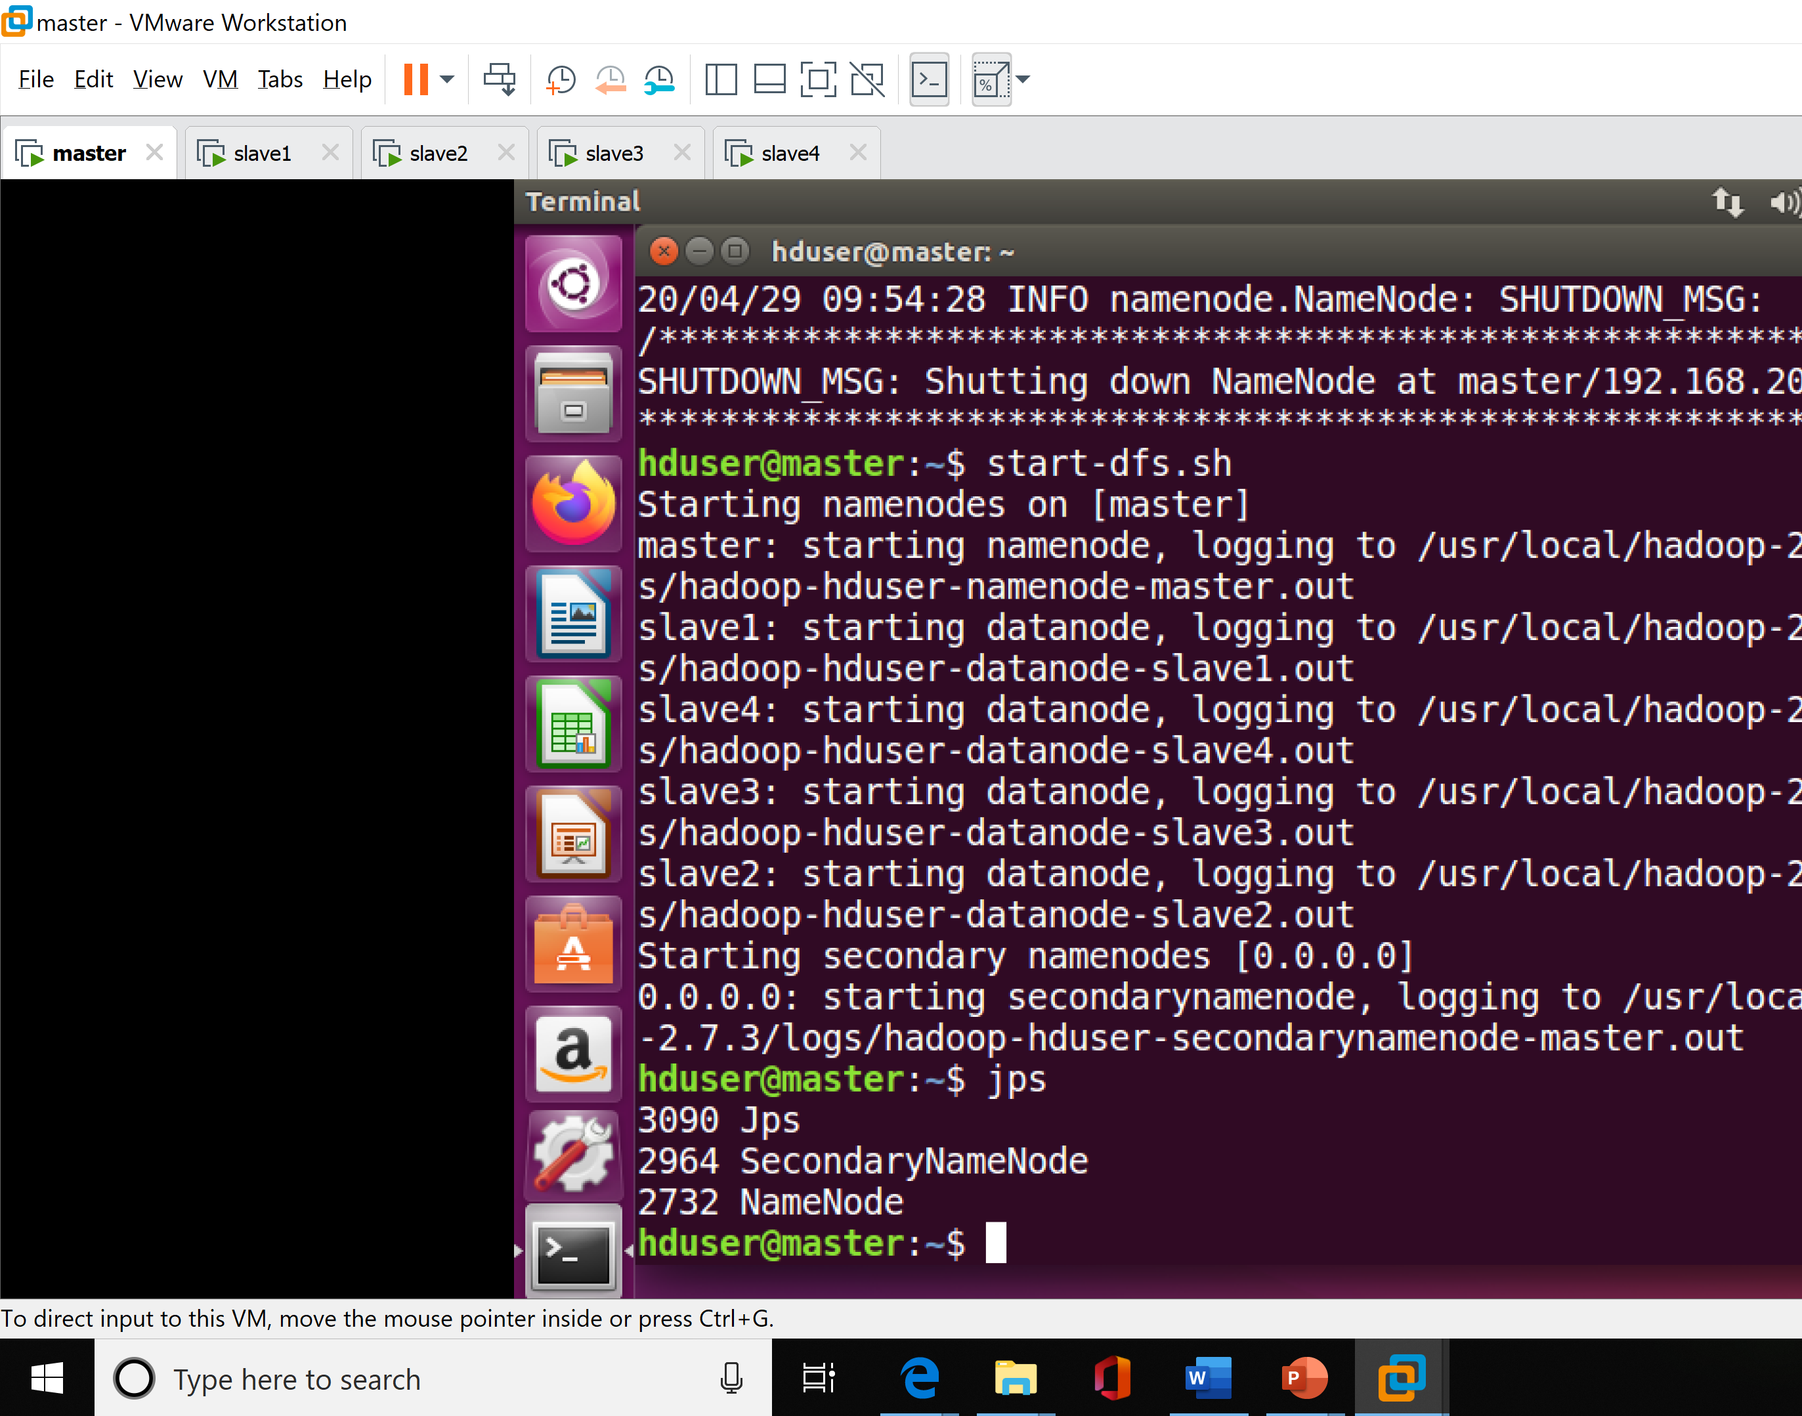
Starting a Multi – Node CLUSTER
4. Automatically Started NodeManager in slaves
1. Started DFS in master
2. Automatically Started node in slaves
3. Started Yarn in Master

Slide 12
What is MapReduce
Hadoop MapReduce (Hadoop Map/Reduce) is a software framework for distributed processing of large data sets on compute clusters of commodity hardware. It is a sub-project of the Apache Hadoop project. The framework takes care of scheduling tasks, monitoring them and re-executing any failed tasks.
According to The Apache Software Foundation, the primary objective of Map/Reduce is to split the input data set into independent chunks that are processed in a completely parallel manner. The Hadoop MapReduce framework sorts the outputs of the maps, which are then input to the reduce tasks. Typically, both the input and the output of the job are stored in a file system.

Slide 13
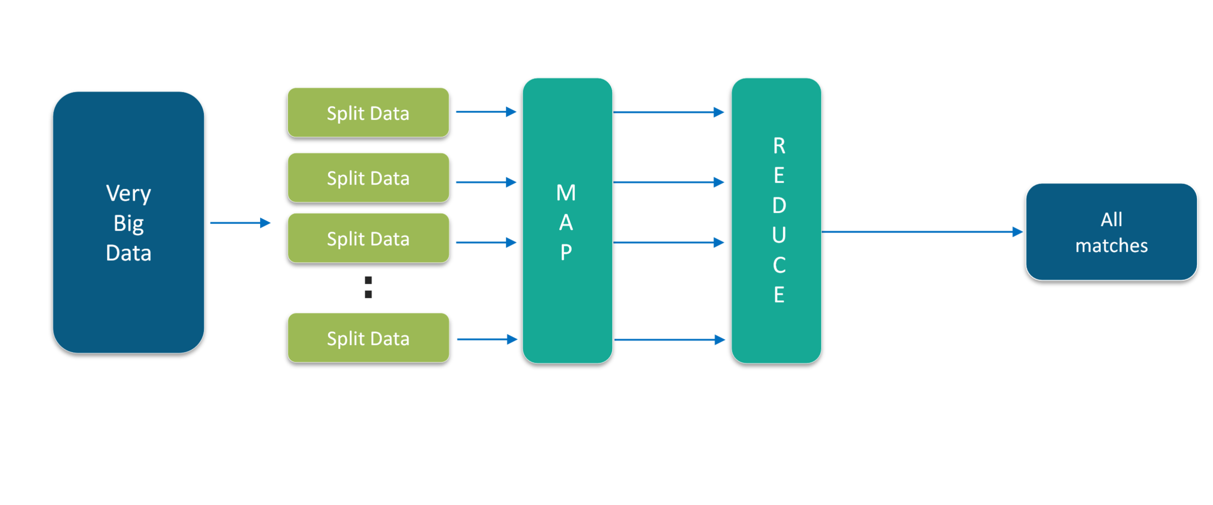
MapReduce Way

Slide 14
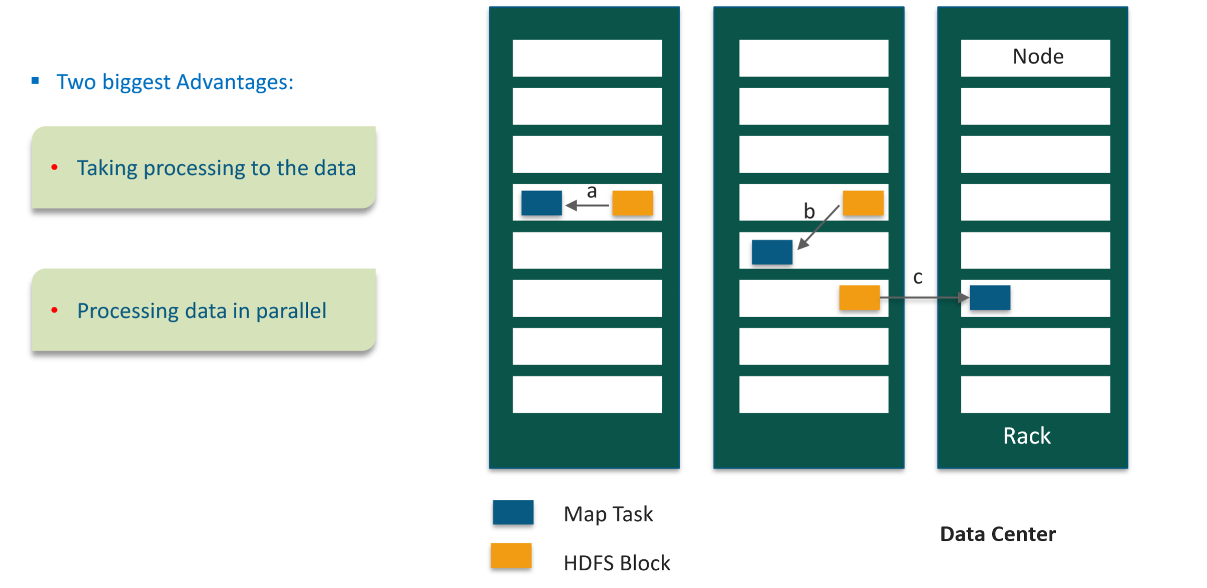
Why MapReduce?

Slide 15
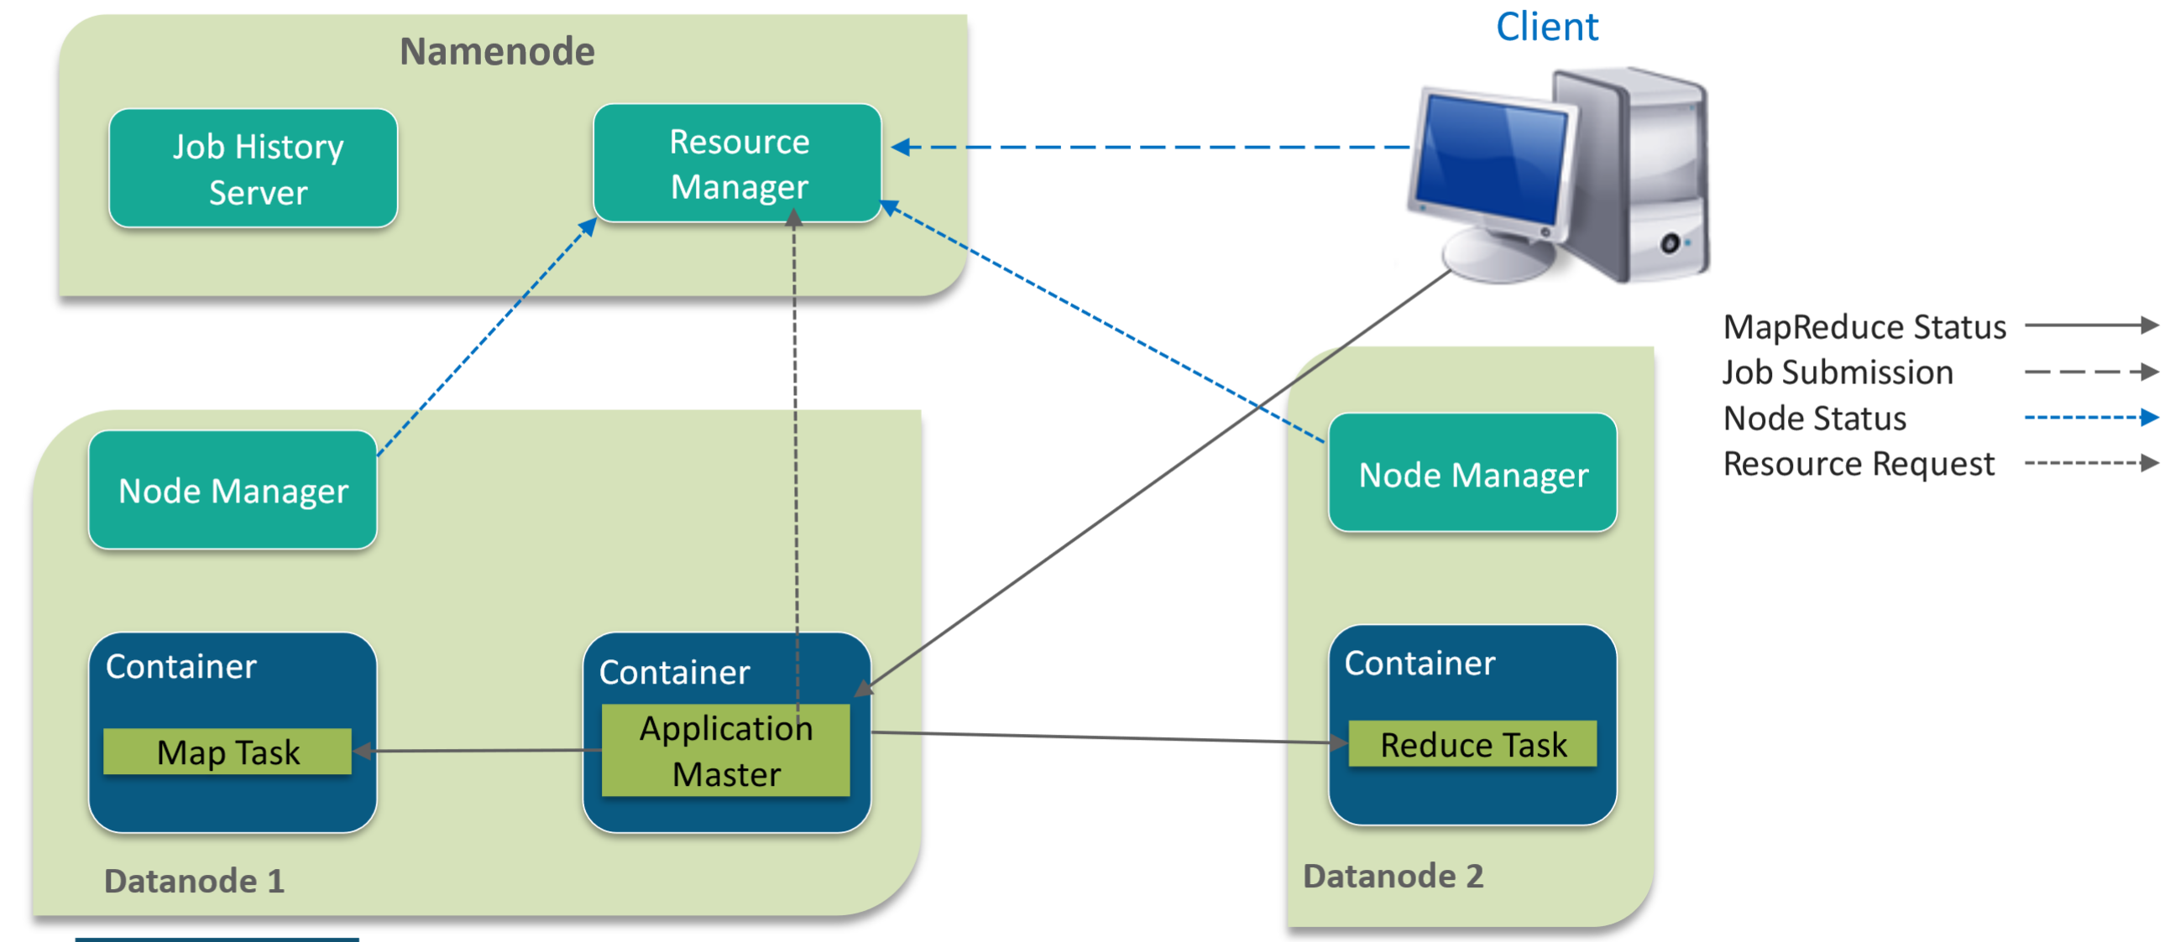
MapReduce Architecture

Slide 16
MapReduce Components -- cont’d..
Client
Submits a MapReduce Job
Resource Manager
Cluster Level resource manager
Long Life, High Quality Hardware
Node Manager
One per Data Node
Monitors resource on Data Node

Slide 17
MapReduce Components
Job History Server
Maintains information about submitted MapReduce jobs after their Application Master terminates
Application Master
One per application
Container
Created by NM when requested
Coordinates and manages MapReduce Jobs
Negotiates with Resource Manager to schedule tasks
The tasks are started by Node Manager
Allocates certain amount of resources (memory, CPU etc.) on slave node

Slide 18
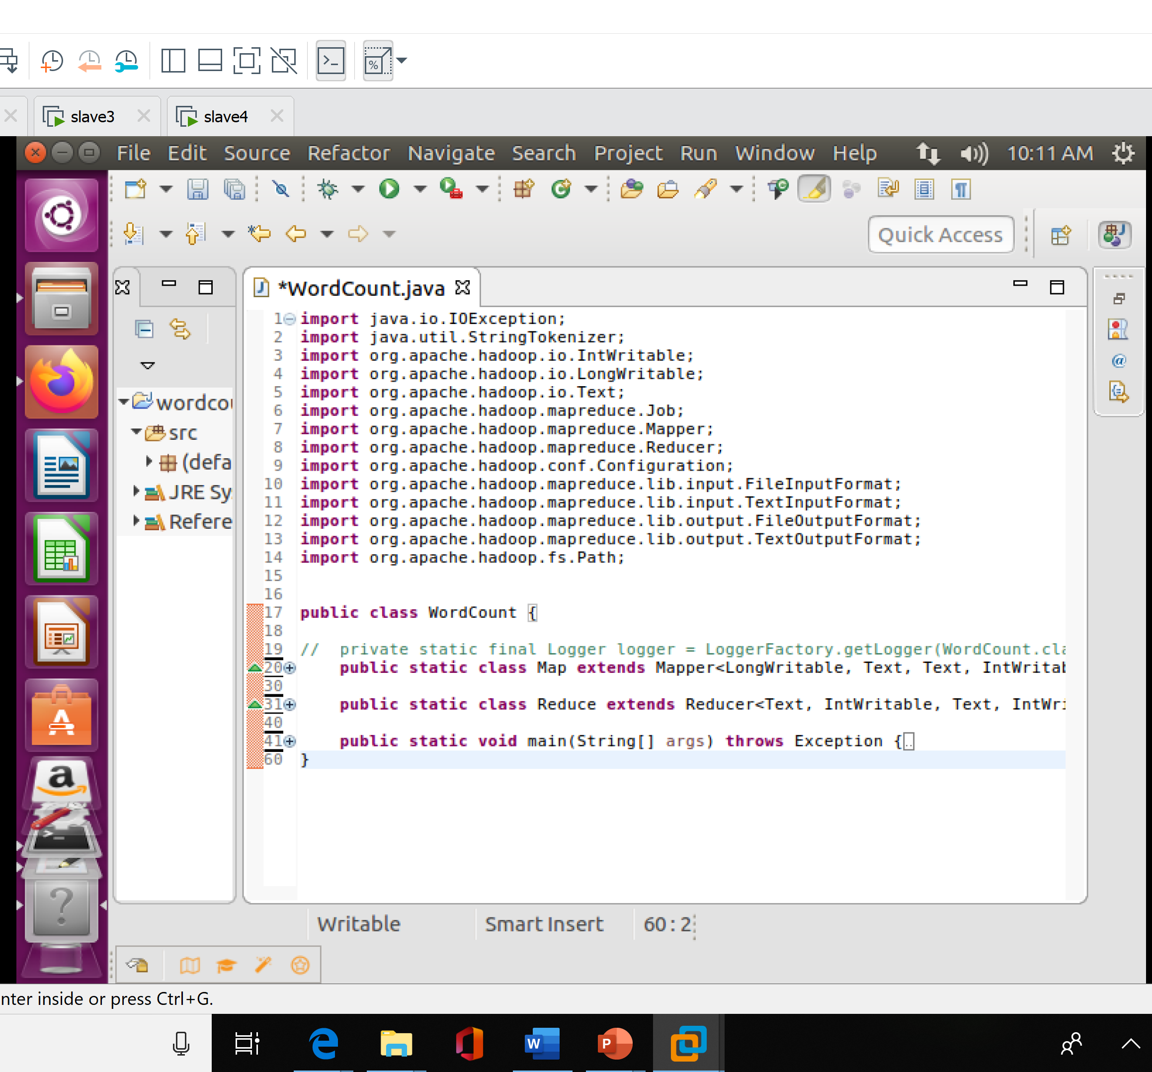
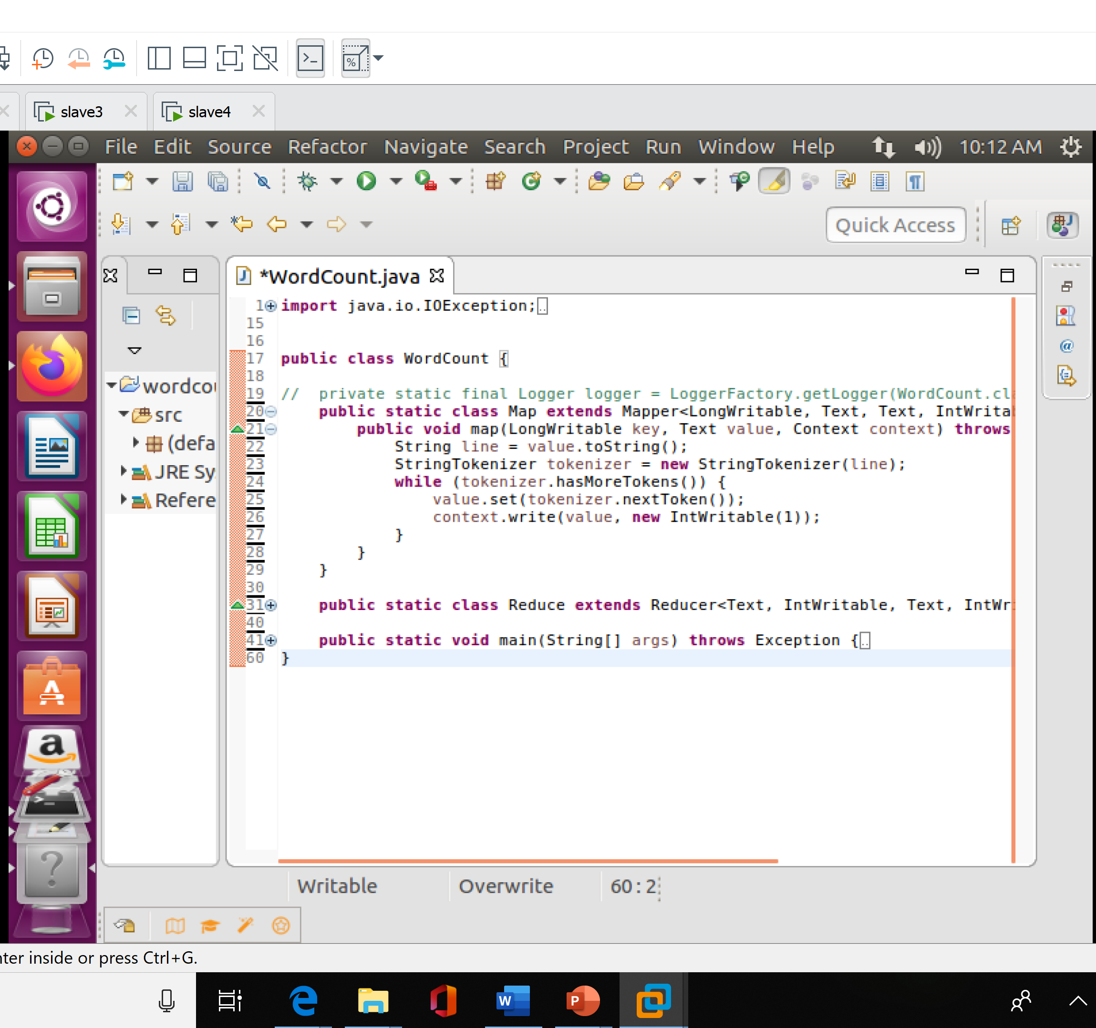
MapReduce– TERM FREQUENCY(Java Code) cont’d..

Slide 19
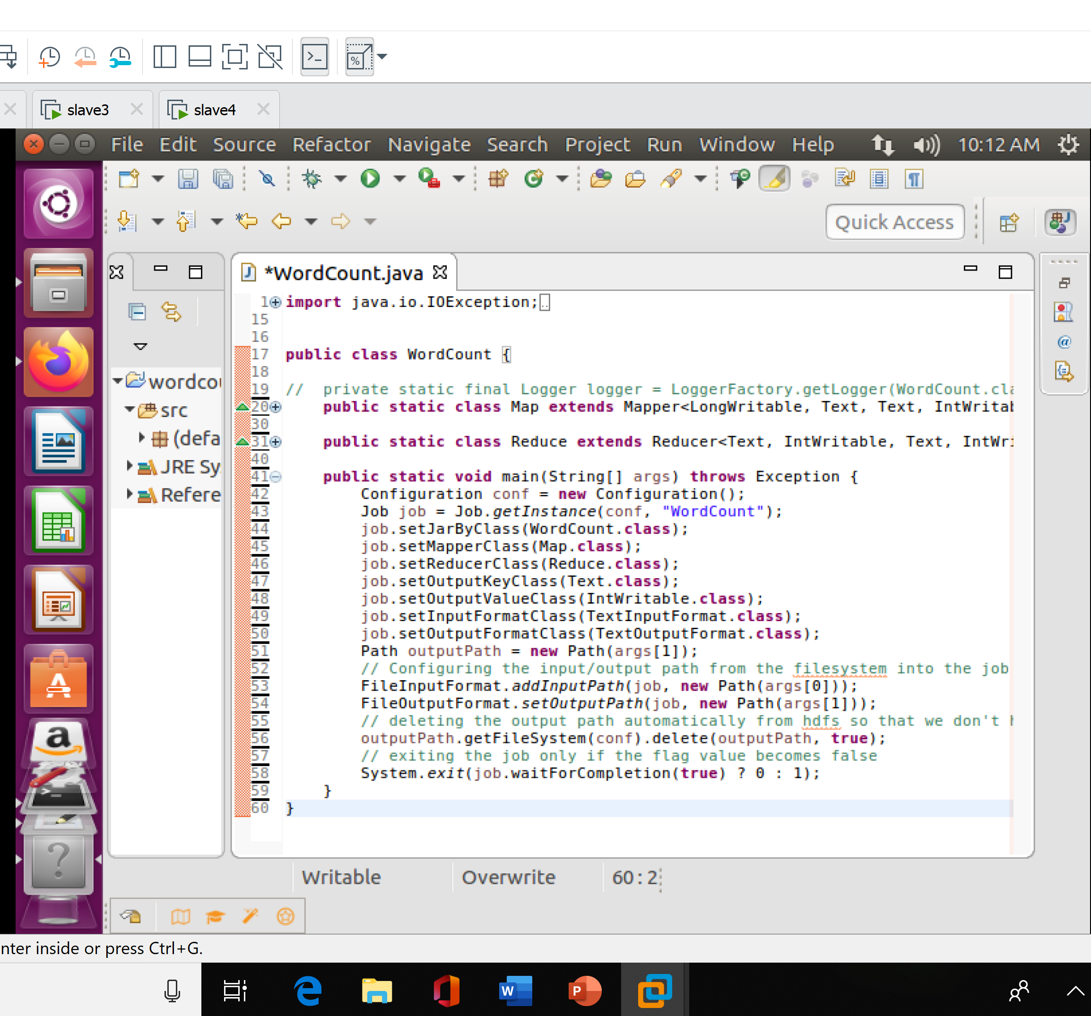

MapReduce– TERM FREQUENCY(Java Code)

Slide 20
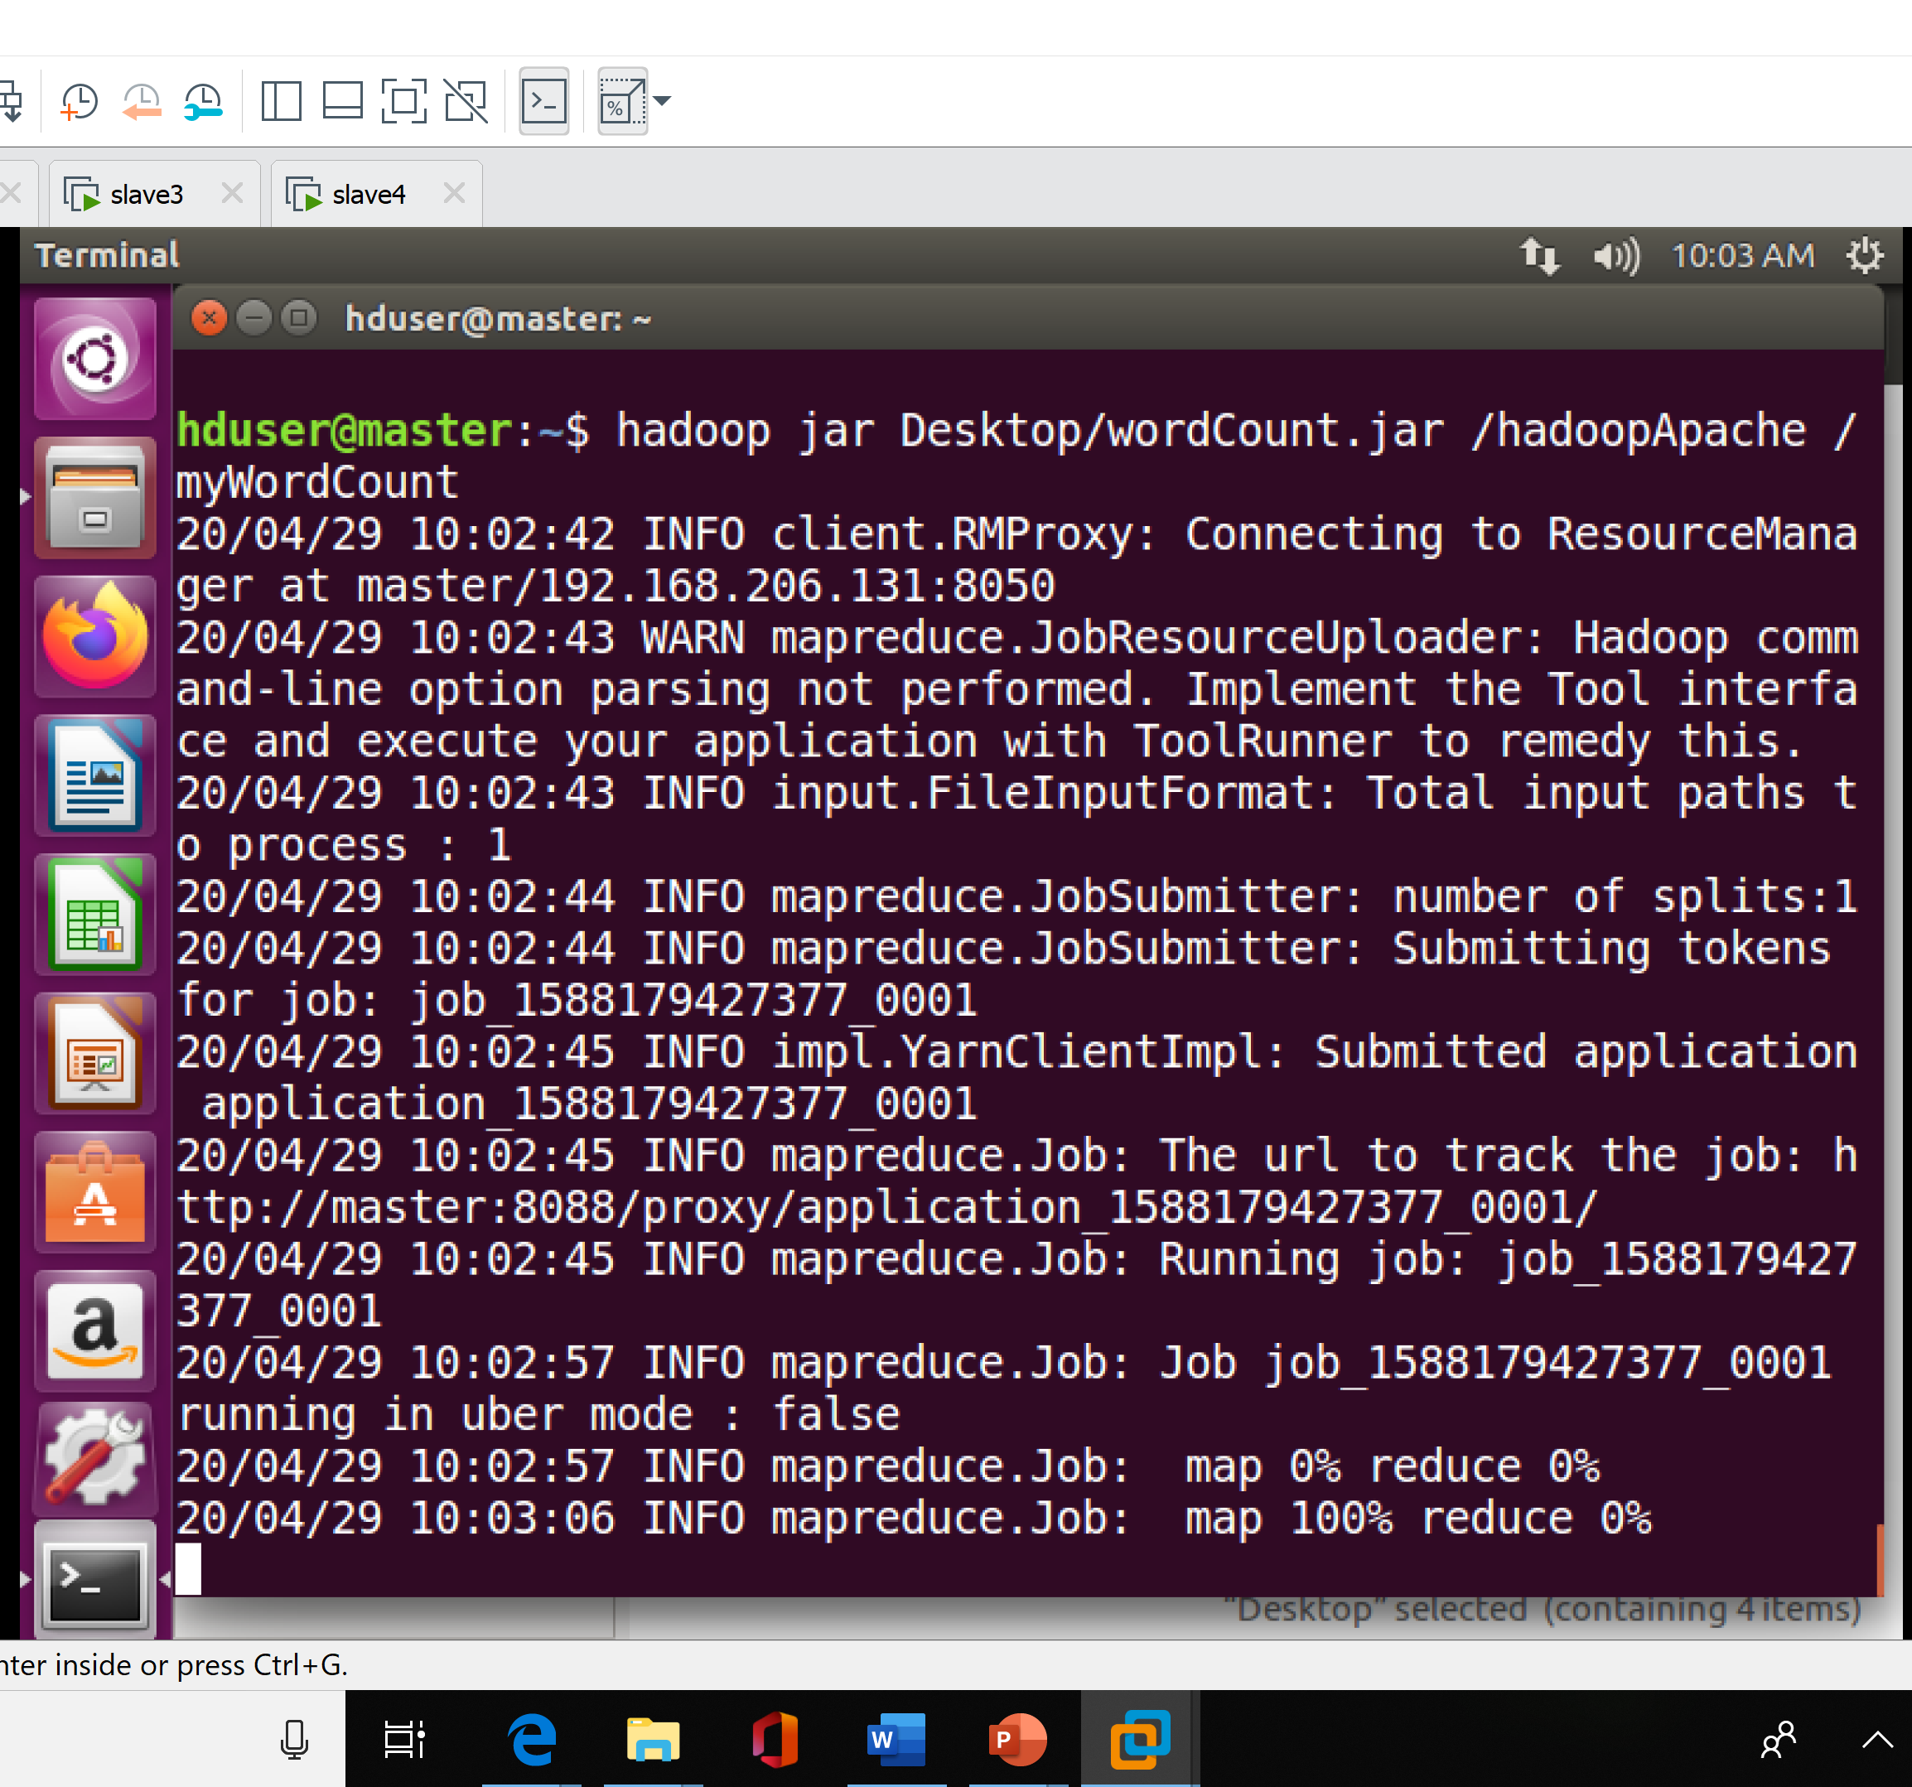
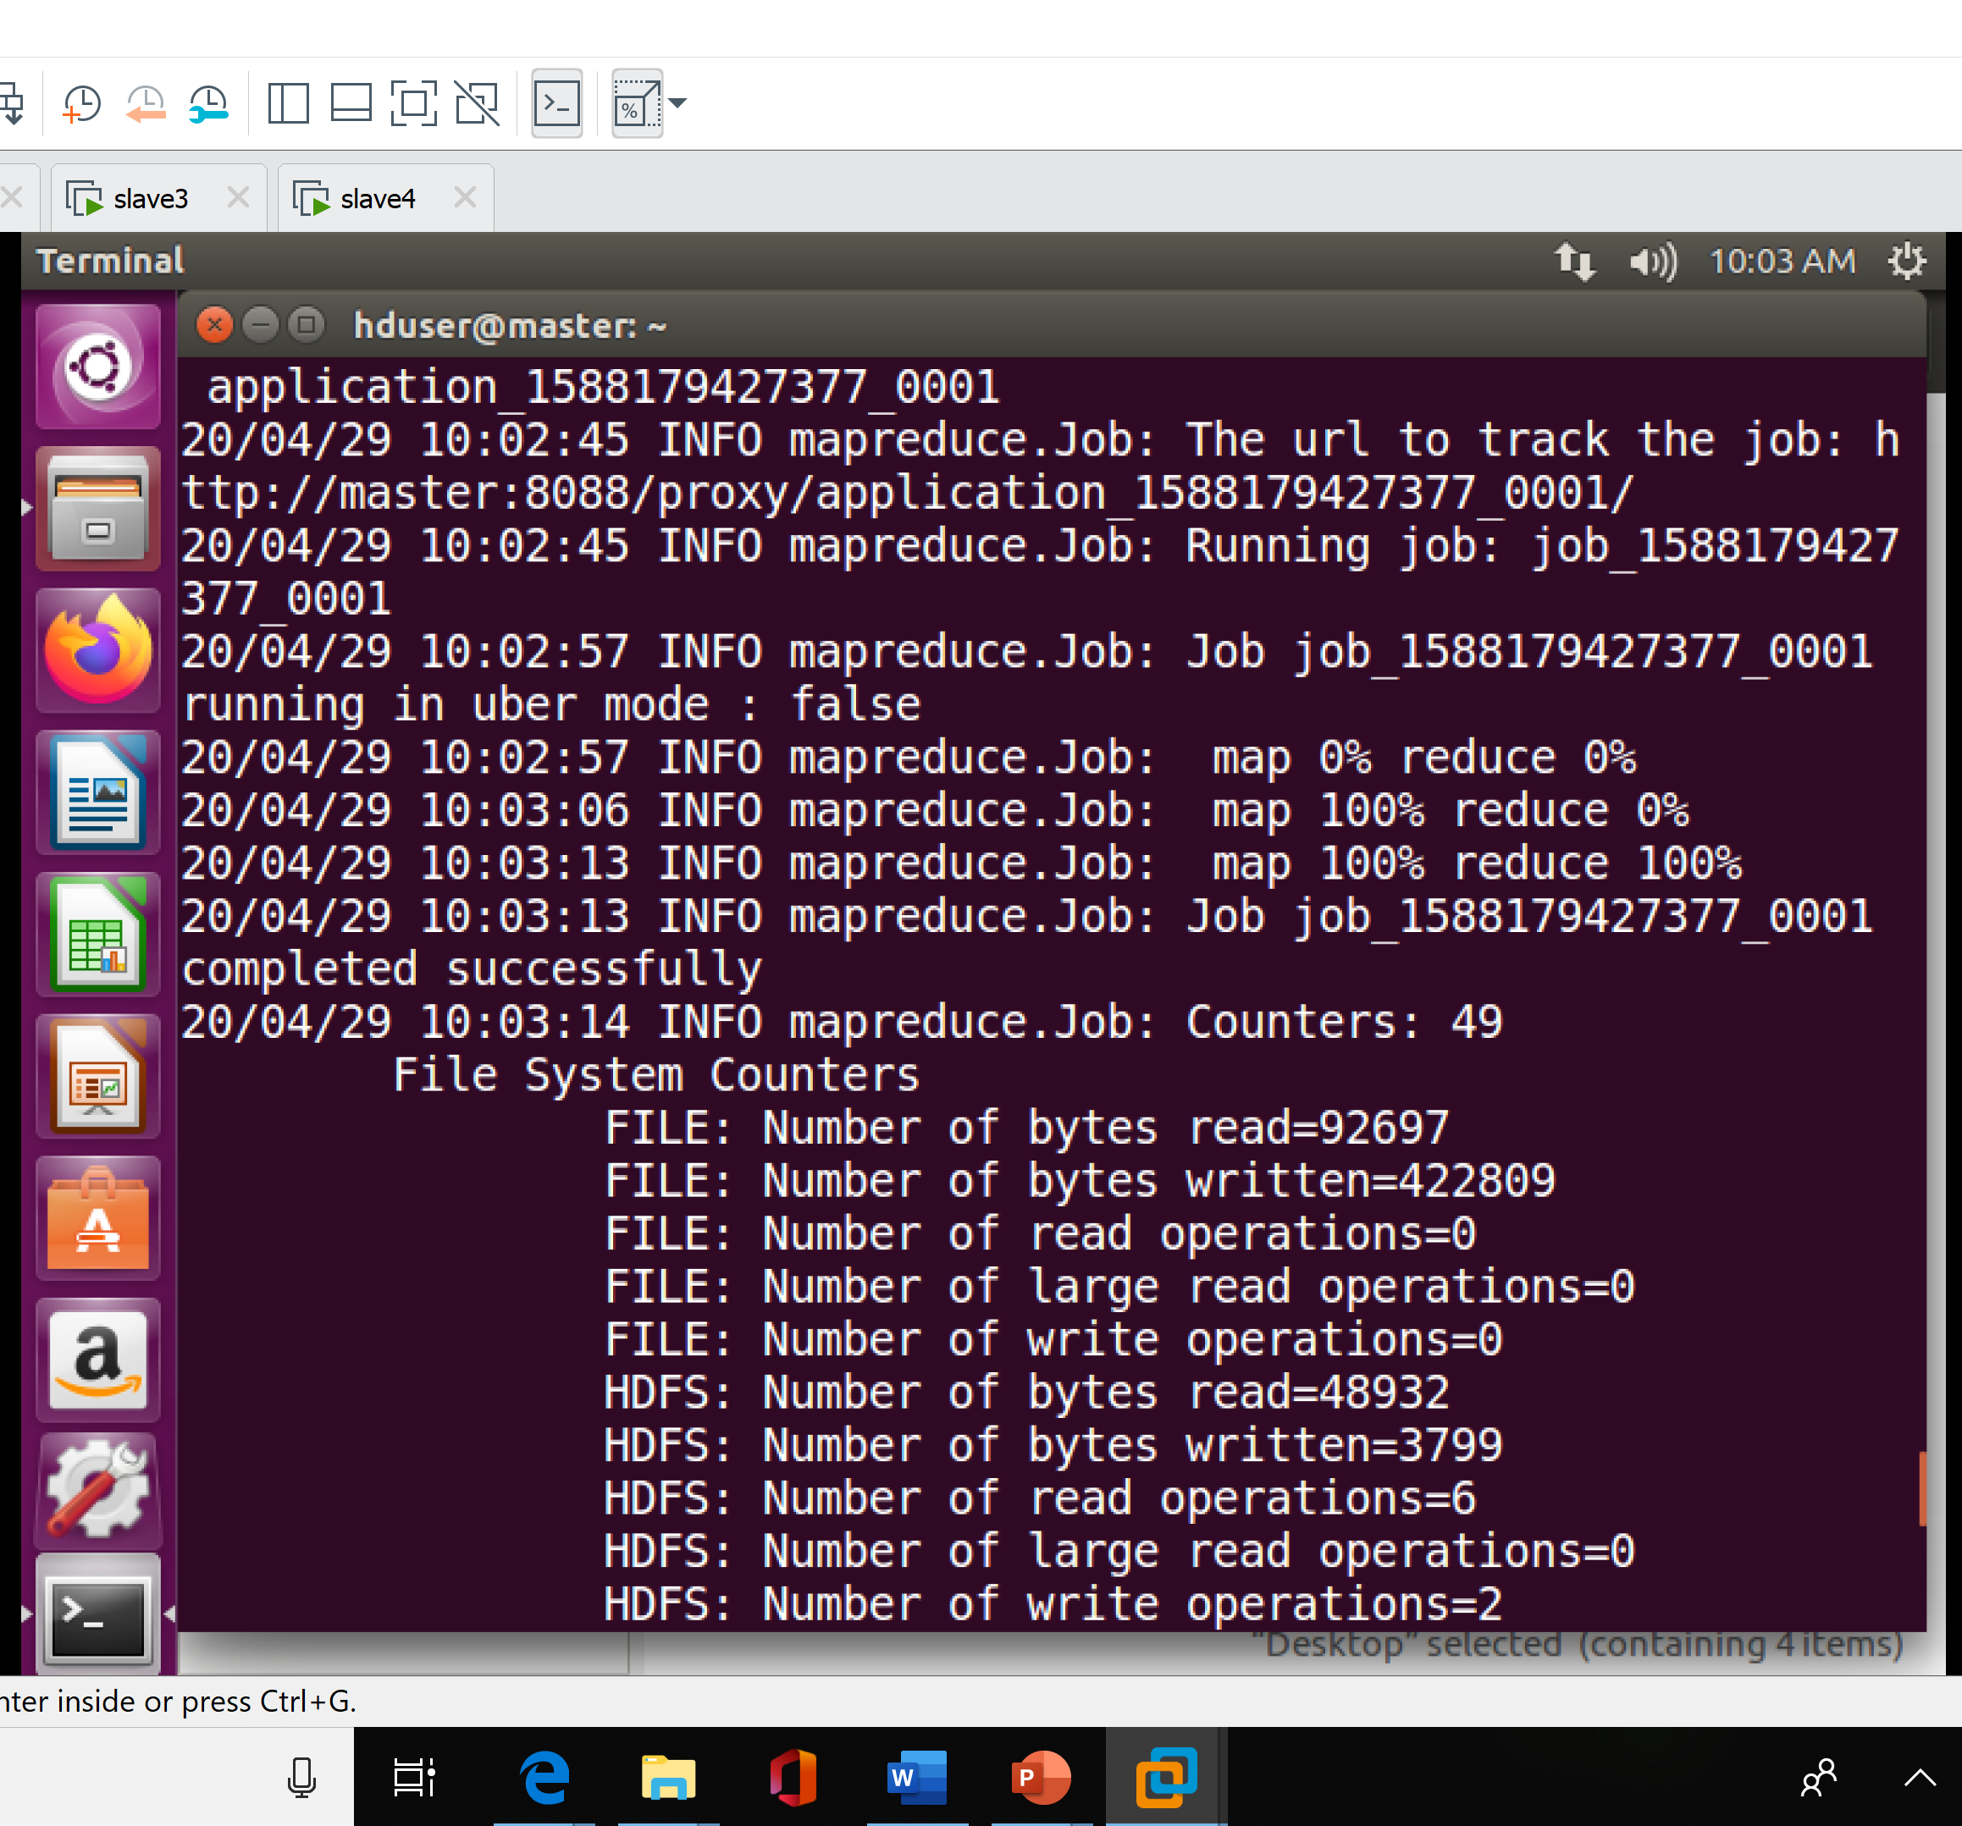
MapReduce Code – TERM FREQUENCY Hadoop Runtime

Slide 21
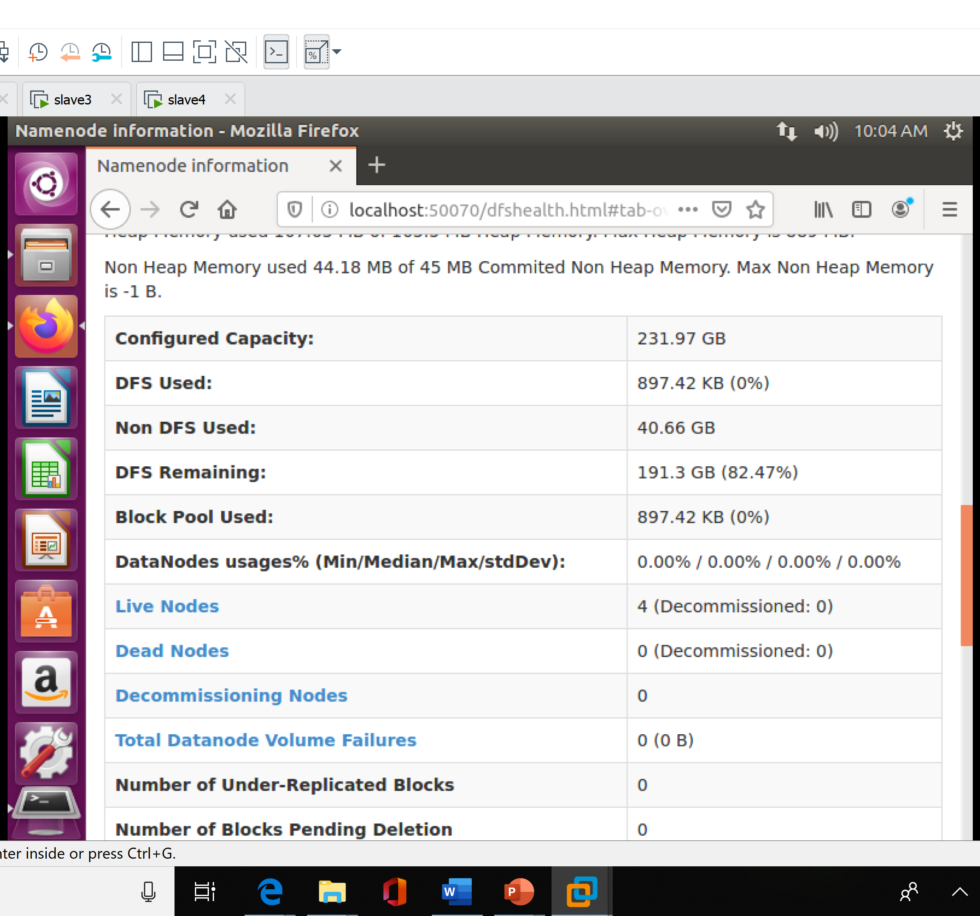
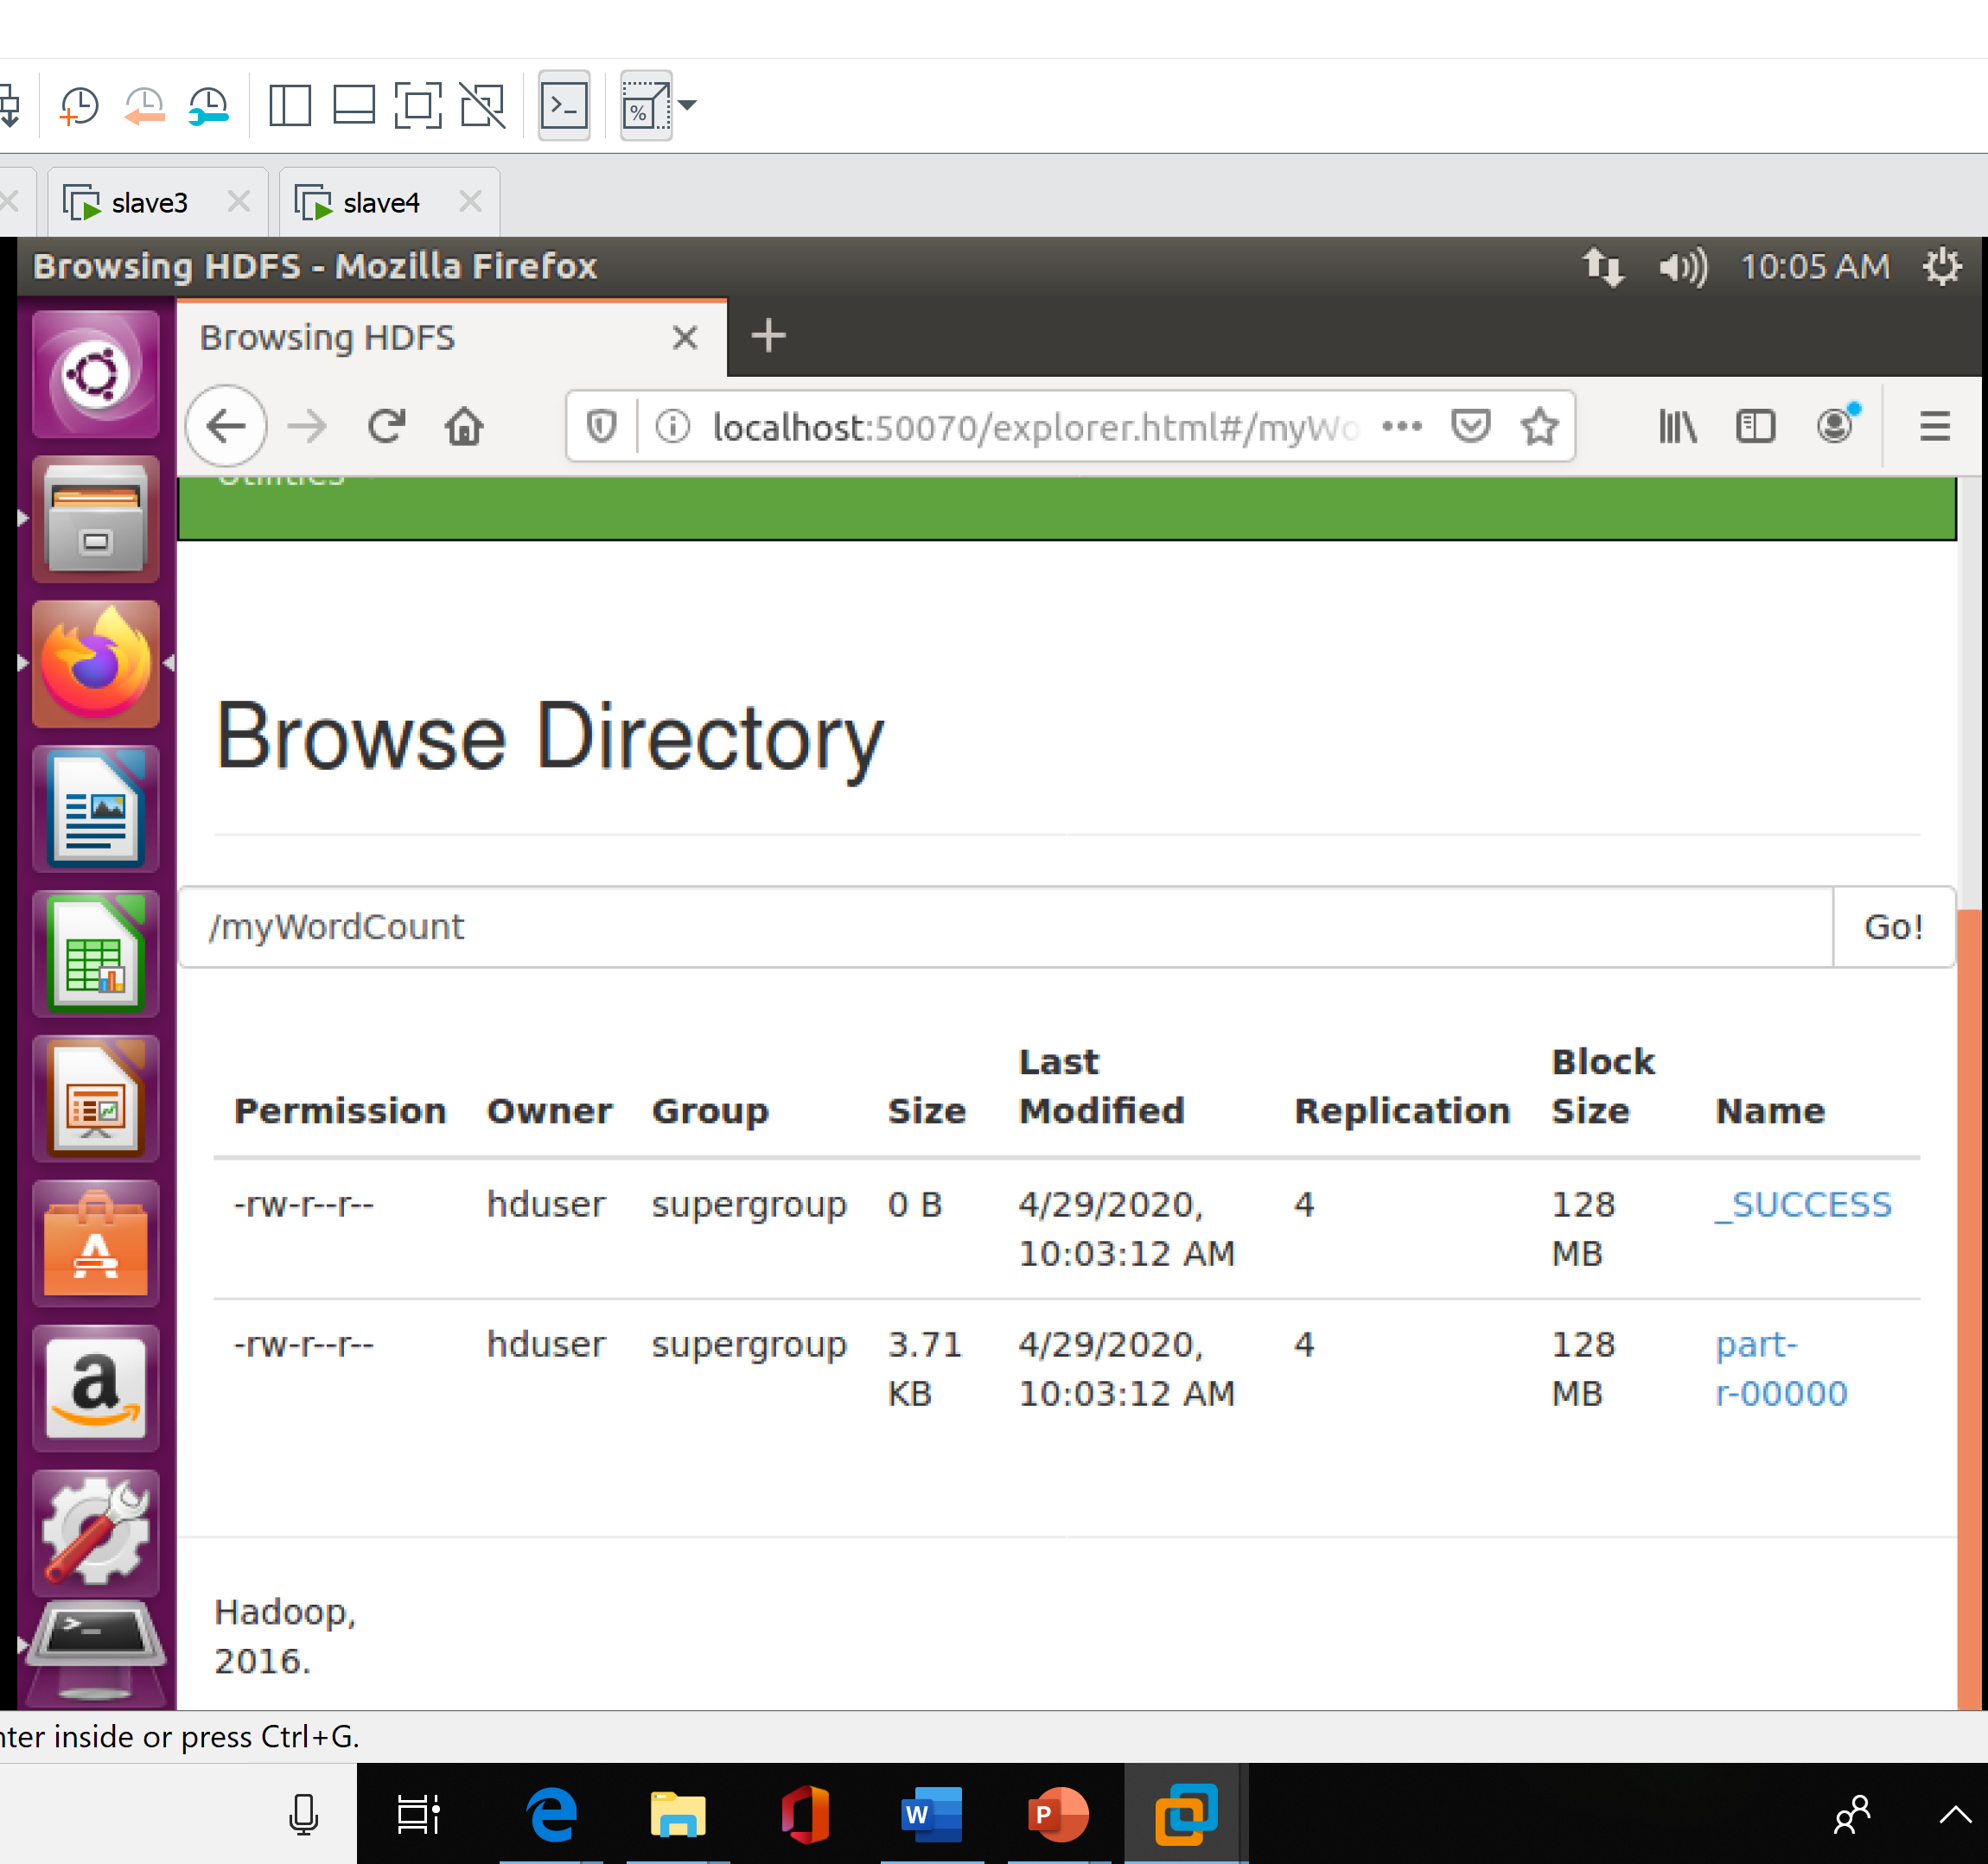
MapReduce Code – TERM FREQUENCY Output in LOCALHOST

Slide 22
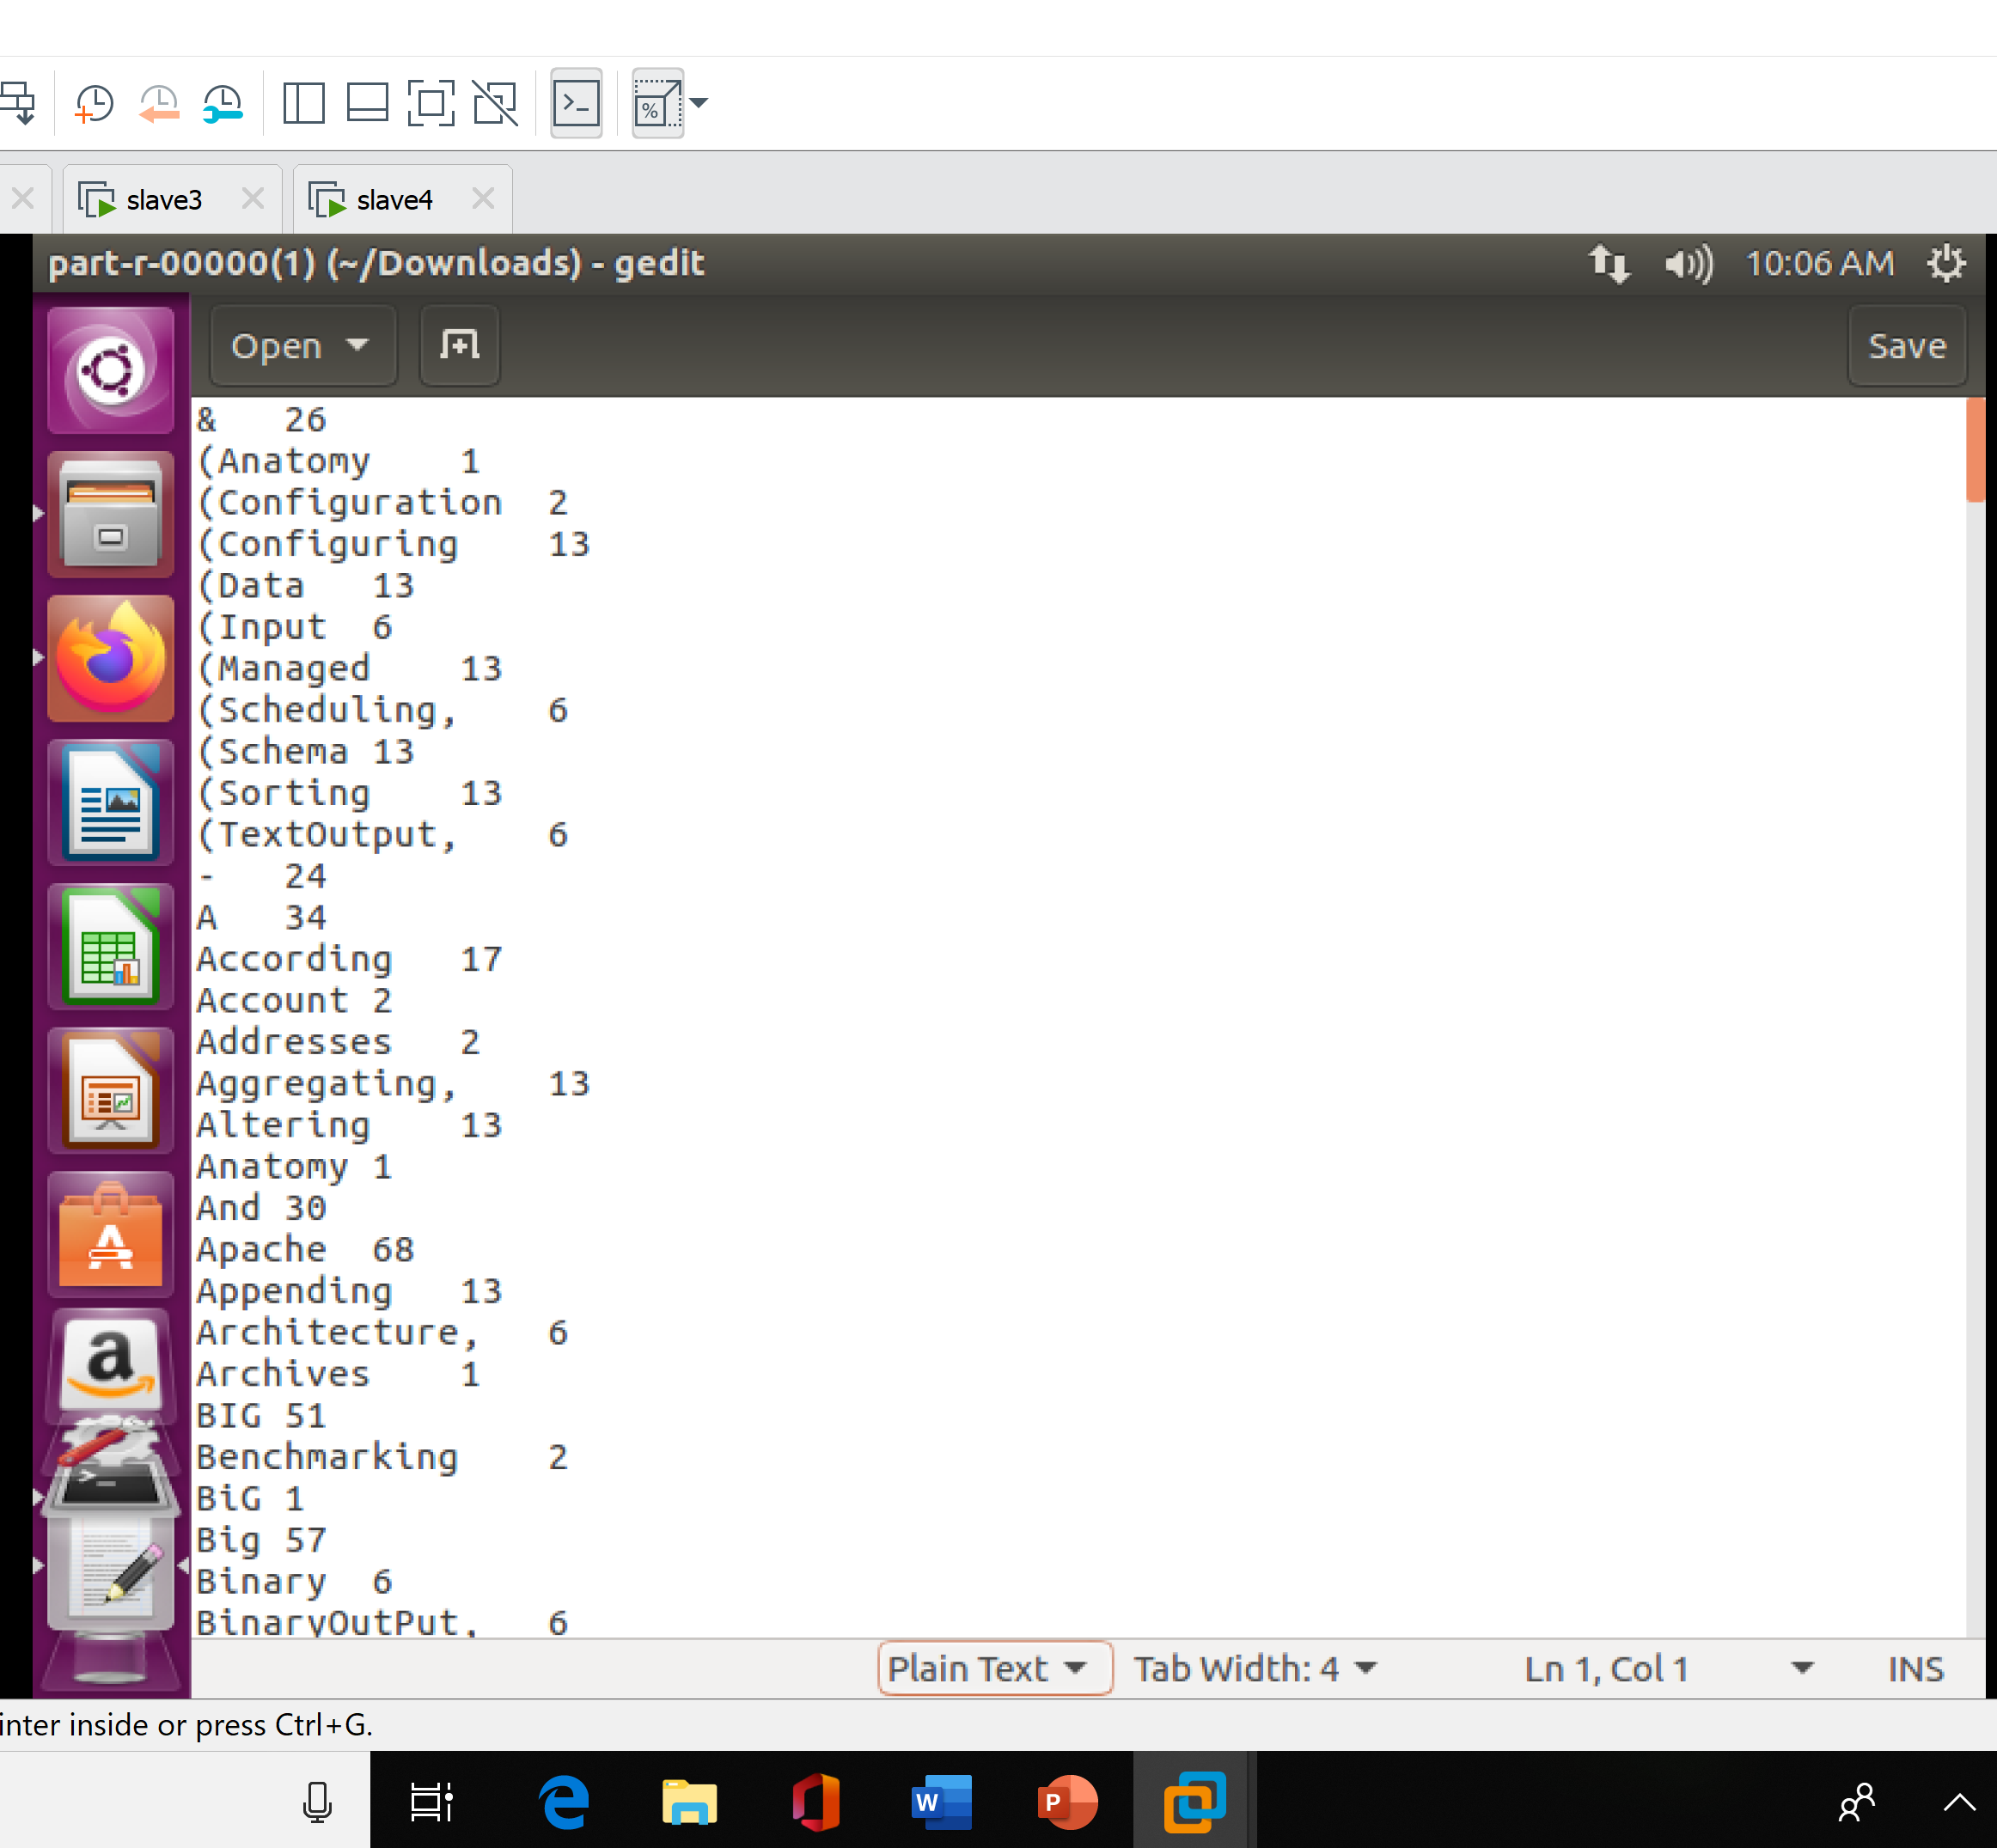
MapReduce Code – TERM FREQUENCY FINAL OUTPUT

Slide 23
Query Processing – PIG
Steps
Download and set PATH for PIG
Load and check dataset in HDFS
Define Dataset
Operations
Print only required information
Ordering information
Filtering
Join Operation
Operations

Slide 24
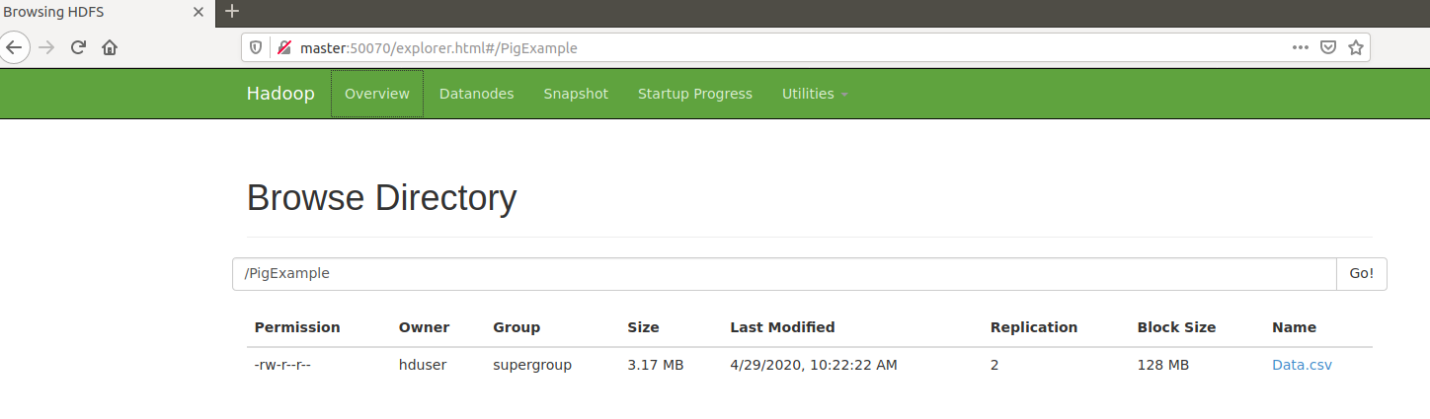
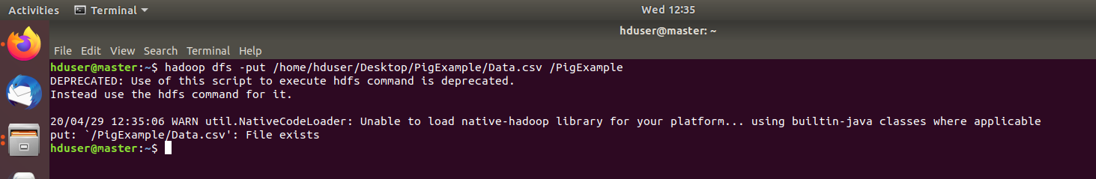
Load and check dataset in HDFS

Slide 25
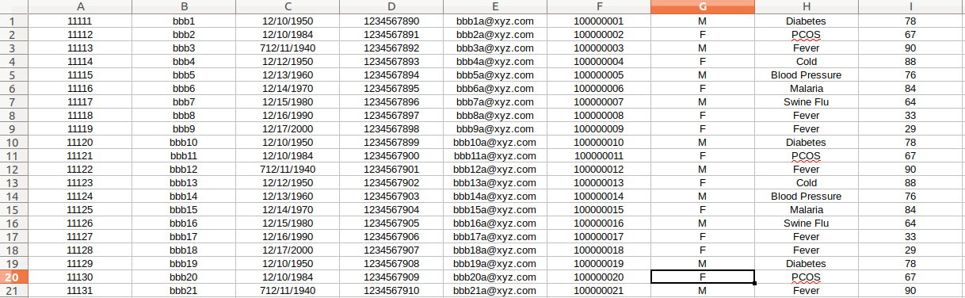
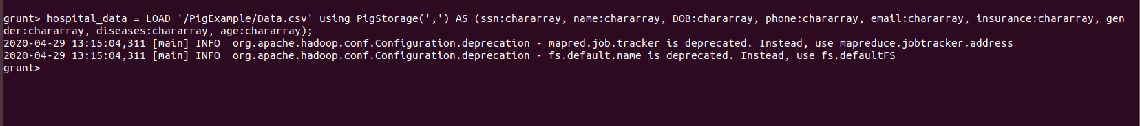
Define Dataset

Slide 26
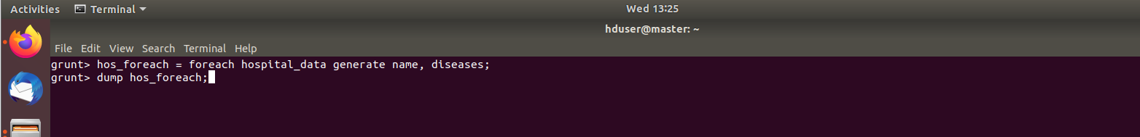
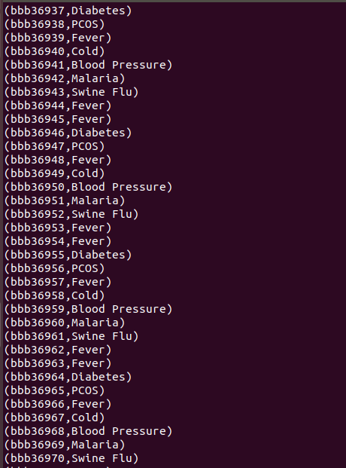
Operations:- 1 Print only required information
Printed only name and diseases

Slide 27
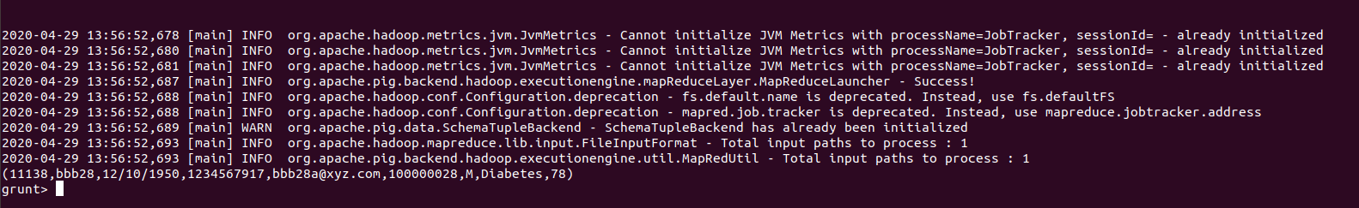
Operations: - 2 Filter
Filtered information using “name”

Slide 28
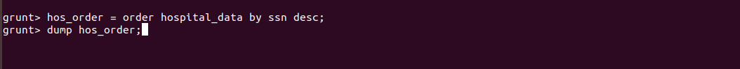
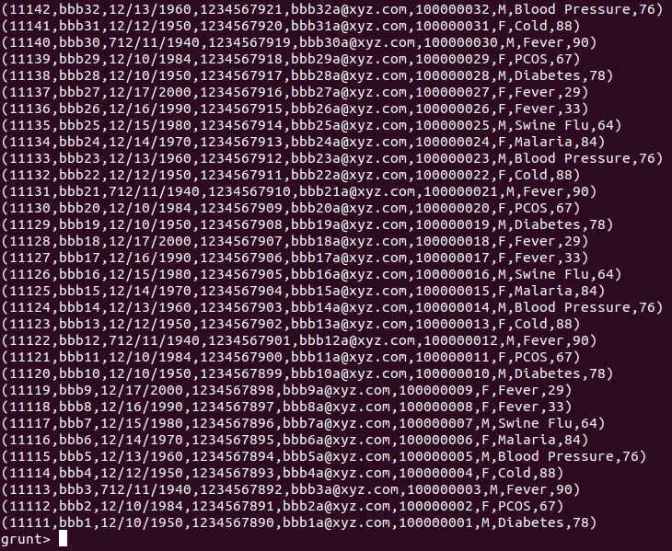
Operations: - 3 Ordering
Ordered according to SSN

Slide 29
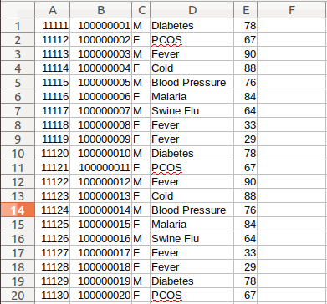
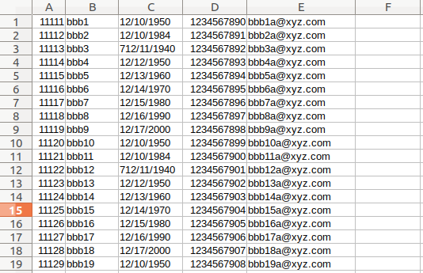
Operations: - 4 Join
Data1
Data2
Upload Data1
Upload Data2

Slide 30
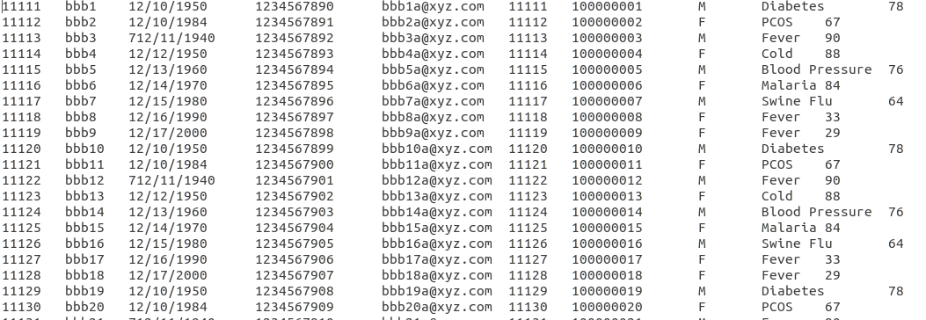
Operations: - 4 (continue…) Join
Define Data1
Define Data1
Join Operation
Output File

Slide 31
THANK YOU FOR YOUR ATTENTION

